Slide 1
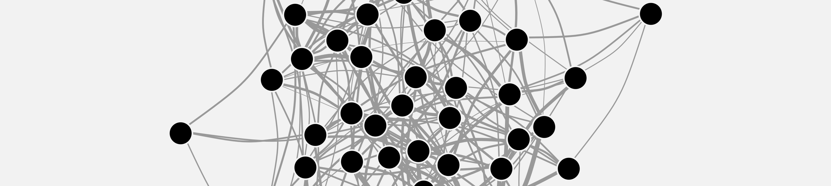


CEFE SOCIAL NETWORKS COURSE
Matthew Silk
matthewsilk@outlook.com

Slide 2

CEFE SOCIAL NETWORKS COURSE
Plan for the next two weeks:
TODAY – What is a network?
06/04/2023 - How do we describe network structures?
13/04/2023 - How do we test hypotheses in networks?
14/04/2023 - Extend our network skillset
Course materials: https://github.com/NETDEM-project/CEFE_Networks_Course

Slide 3
CEFE SOCIAL NETWORKS COURSE
Plan for today:
What is a network?
What do network datasets look like?
Network basics in R
Simple theoretical models of networks
Generating networks in R
Different network representations

Slide 4

CEFE SOCIAL NETWORKS COURSE
What is a network?
Networks represent interactions and consist of:
Nodes/vertices/actors
connected by
Links/edges

Slide 5
CEFE SOCIAL NETWORKS COURSE
What is a network?
Networks represent interactions and consist of:
Nodes/vertices/actors
connected by
Links/edges

Slide 6




CEFE SOCIAL NETWORKS COURSE
What is a network?
Nodes
Networks represent interactions and consist of:
Nodes/vertices/actors
connected by
Links/edges

Slide 7

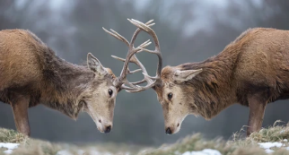



CEFE SOCIAL NETWORKS COURSE
What is a network?
Nodes
Networks represent interactions and consist of:
Nodes/vertices/actors
connected by
Links/edges
Edges

Slide 8
CEFE SOCIAL NETWORKS COURSE
What is a network?

Slide 9
CEFE SOCIAL NETWORKS COURSE
What is a network?
Networks help link individual behaviours to population patterns

Slide 10
CEFE SOCIAL NETWORKS COURSE
What do network datasets look like?
a) An ADJACENCY MATRIX
 | 1 | 2 | 3 | 4 | 5 | 6 | 7 | 8
1 | 0 | 1 | 1 | 0 | 0 | 1 | 0 | 0
2 | 1 | 0 | 0 | 1 | 0 | 0 | 0 | 0
3 | 1 | 0 | 0 | 1 | 1 | 0 | 0 | 0
4 | 0 | 1 | 1 | 0 | 0 | 0 | 0 | 0
5 | 0 | 0 | 1 | 0 | 0 | 1 | 1 | 0
6 | 1 | 0 | 0 | 0 | 1 | 0 | 1 | 0
7 | 0 | 0 | 0 | 0 | 1 | 1 | 0 | 1
8 | 0 | 0 | 0 | 0 | 0 | 0 | 1 | 0
1
2
3
4
5
6
7
8

Slide 11
CEFE SOCIAL NETWORKS COURSE
What do network datasets look like?
b) An EDGE LIST
ID 1 | ID 2
1 | 2
1 | 3
1 | 6
2 | 4
3 | 4
3 | 5
5 | 6
5 | 7
6 | 7
7 | 8
1
2
3
4
5
6
7
8

Slide 12
CEFE SOCIAL NETWORKS COURSE
What do network datasets look like?
b) An EDGE LIST
ID 1 | ID 2 | Attribute
1 | 2
1 | 3
1 | 6
2 | 4
3 | 4
3 | 5
5 | 6
5 | 7
6 | 7
7 | 8
1
2
3
4
5
6
7
8

Slide 13
CEFE SOCIAL NETWORKS COURSE
What do network datasets look like?
b) An INCIDENCE MATRIX or GROUP-BY-INDIVIDUAL MATRIX
Groups
1
2
3
4
5
6
7
8
9
10
Individuals | 2 | 3 | 4 | 5 | 6 | 7 | 8
1 | 2 | 3 | 4 | 5 | 6 | 7 | 8
1 | 1 | 0 | 0 | 0 | 0 | 0 | 0
1 | 0 | 1 | 0 | 0 | 0 | 0 | 0
1 | 0 | 0 | 0 | 0 | 1 | 0 | 0
0 | 1 | 0 | 1 | 0 | 0 | 0 | 0
0 | 0 | 1 | 1 | 0 | 0 | 0 | 0
0 | 0 | 1 | 0 | 1 | 0 | 0 | 0
0 | 0 | 0 | 0 | 1 | 1 | 0 | 0
0 | 0 | 0 | 0 | 1 | 0 | 1 | 0
0 | 0 | 0 | 0 | 0 | 1 | 1 | 0
0 | 0 | 0 | 0 | 0 | 0 | 1 | 1
1
2
3
4
5
6
7
8

Slide 14
CEFE SOCIAL NETWORKS COURSE
Network basics in R
Now head to the R Markdown for Session 1 and work through the section SESSION 1: PART 3

Slide 15
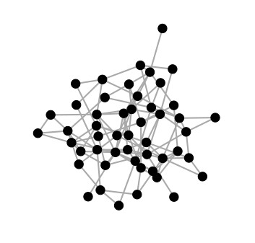
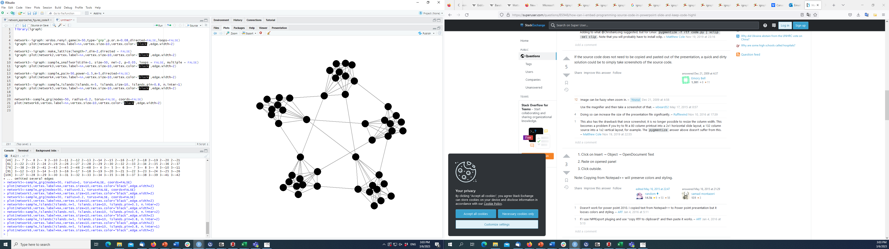
CEFE SOCIAL NETWORKS COURSE
Simple theoretical models of networks
Random networks
Erdos-renyi model
The most basic network model
Requires only a probability of edges or number of edges, and a number of nodes
Edges conditionally independent

Slide 16
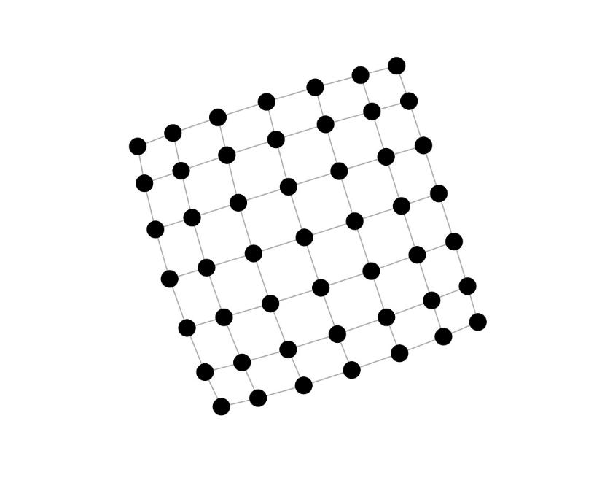
CEFE SOCIAL NETWORKS COURSE
Simple theoretical models of networks
Lattice network
A basic “geographic” model
Connections between neighbours in a lattice
Can specify the lattice to have any dimension you like

Slide 17
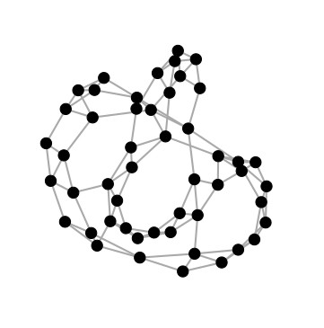
CEFE SOCIAL NETWORKS COURSE
Simple theoretical models of networks
Small-world networks
Watts-Strogatz model
Extends a lattice model to include occasional long-distance connections
Often a good approximation for many real-world social networks
Characterised by clustering of nodes but still with short routes across the network

Slide 18
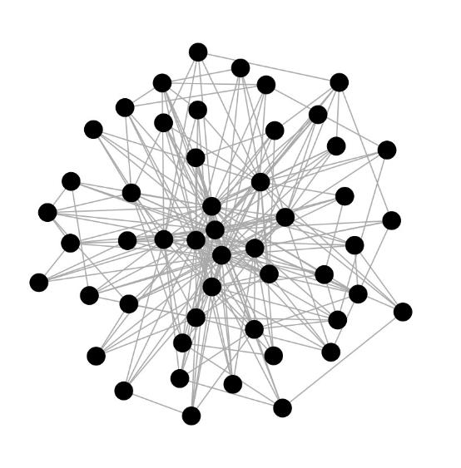
CEFE SOCIAL NETWORKS COURSE
Simple theoretical models of networks
Preferential attachment
Barabasi-Albert model
A model that allows individuals to vary in their “sociality” or “popularity”
Uses a mechanism called preferential attachment
Animal social networks often have these heterogeneous degree distributions
(but may not be scale free)

Slide 19
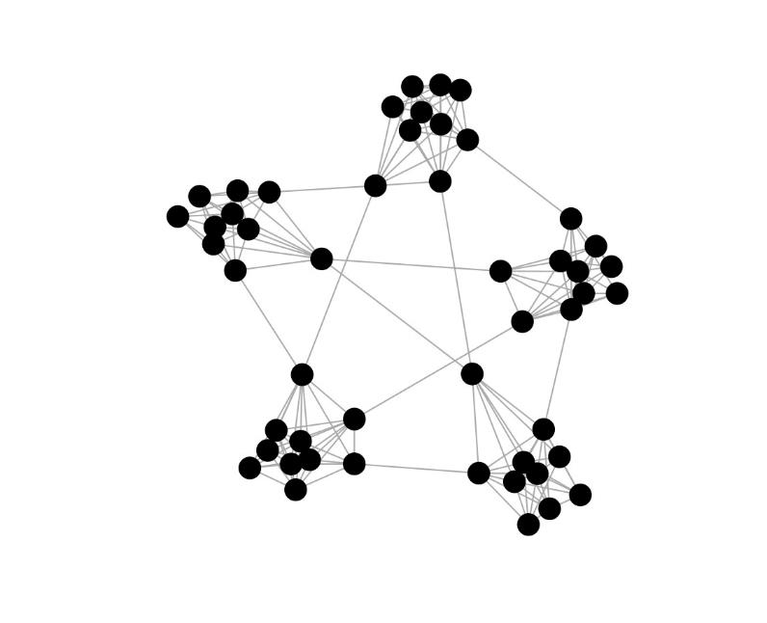
CEFE SOCIAL NETWORKS COURSE
Simple theoretical models of networks
Modular networks
An example of a model that can generate networks with group or (community/modular) structure
These types of modular network are common in some animal societies

Slide 20
CEFE SOCIAL NETWORKS COURSE
Generating networks in R
A full list of igraph functions is here: https://igraph.org/r/html/latest/
You can find a lot of functions to generate simple networks by searching “game” in this list

Slide 21
CEFE SOCIAL NETWORKS COURSE
Generating networks in R
A full list of igraph functions is here: https://igraph.org/r/html/latest/
You can find a lot of functions to generate simple networks by searching “game” in this list
1. Go to the R Markdown for Session 1 and work through the section SESSION 1: PART 4
2. In groups find models and simulate networks for:
A species with stable social groups that never mix
A territorial species with occasional long-distance dispersal
A species with fission-fusion social groups that separate and come back together
A species with social groups with some individuals much more connected than others

Slide 22
CEFE SOCIAL NETWORKS COURSE
Different network representations
We have started with the most simple way to think about animal social networks – recording simply whether two individuals share a social connection or not.
BUT
The social lives of animals are much more complex than this, so in the next section we are going to go through different ways to include extra information in our social network representations.

Slide 23
CEFE SOCIAL NETWORKS COURSE
Different network representations
We have started with the most simple way to think about animal social networks – recording simply whether two individuals share a social connection or not.
BUT
The social lives of animals are much more complex than this, so in the next section we are going to go through different ways to include extra information in our social network representations.
We will start with types of static representation that ignore how interactions might change over time to account for:
The frequency and duration of interactions (weighted networks and multigraphs)
Who interacted with whom (directed networks and ego networks)
Different types of behaviour (multilayer networks)
Indirect interactions (bipartite networks)
Group interactions (higher-order networks)

Slide 24
CEFE SOCIAL NETWORKS COURSE
Different network representations
We have started with the most simple way to think about animal social networks – recording simply whether two individuals share a social connection or not.
BUT
The social lives of animals are much more complex than this, so in the next section we are going to go through different ways to include extra information in our social network representations.
We will start with types of static representation that ignore how interactions might change over time to account for:
The frequency and duration of interactions (weighted networks and multigraphs)
Who interacted with whom (directed networks and ego networks)
Different types of behaviour (multilayer networks)
Indirect interactions (bipartite networks)
Group interactions (higher-order networks)
We will then finish by thinking about dynamic representations that include information about temporal changes to interaction patterns

Slide 25
CEFE SOCIAL NETWORKS COURSE
Static network representations
Weighted networks are commonly used to study animal social networks
Also provide information on the strength of social connections
ID 1 | ID 2 | Attribute
1 | 2 | 3
1 | 3 | 1
1 | 6 | 1
2 | 4 | 1
3 | 4 | 1
3 | 5 | 1
5 | 6 | 2
5 | 7 | 2
6 | 7 | 2
7 | 8 | 1
 | 1 | 2 | 3 | 4 | 5 | 6 | 7 | 8
1 | 0 | 3 | 1 | 0 | 0 | 1 | 0 | 0
2 | 3 | 0 | 0 | 1 | 0 | 0 | 0 | 0
3 | 1 | 0 | 0 | 1 | 1 | 0 | 0 | 0
4 | 0 | 1 | 1 | 0 | 0 | 0 | 0 | 0
5 | 0 | 0 | 1 | 0 | 0 | 2 | 2 | 0
6 | 1 | 0 | 0 | 0 | 2 | 0 | 2 | 0
7 | 0 | 0 | 0 | 0 | 2 | 2 | 0 | 1
8 | 0 | 0 | 0 | 0 | 0 | 0 | 1 | 0
1
2
3
4
5
6
7
8

Slide 26
CEFE SOCIAL NETWORKS COURSE
Static network representations
There are lots of different ways to weight social network edges
Counts of associations/interactions

Slide 27
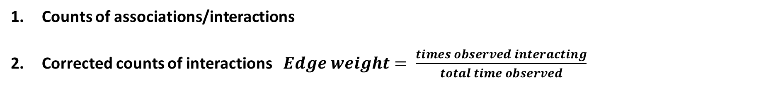
CEFE SOCIAL NETWORKS COURSE
Static network representations
There are lots of different ways to weight social network edges
Counts of associations/interactions
Corrected counts of interactions $Edge weight= \frac{times observed interacting}{total time observed}$

Slide 28
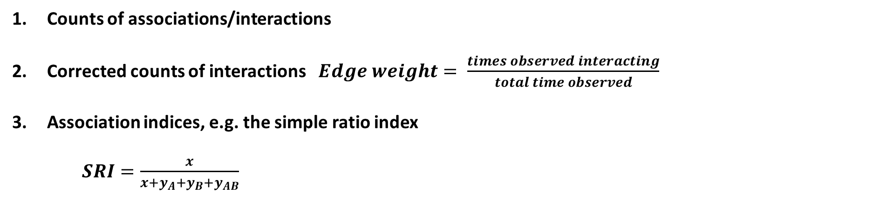
CEFE SOCIAL NETWORKS COURSE
Static network representations
There are lots of different ways to weight social network edges
Counts of associations/interactions
Corrected counts of interactions $Edge weight= \frac{times observed interacting}{total time observed}$
Association indices, e.g. the simple ratio index
$SRI=\frac{x}{x+y_{A}+y_{B}+y_{AB}}$
Lots of variations which are described here: https://doi.org/10.1016/j.anbehav.2017.08.029
Number of times A and B observed together
Number of times just A observed
Number of times just B observed
Number of times A and B observed separately

Slide 29
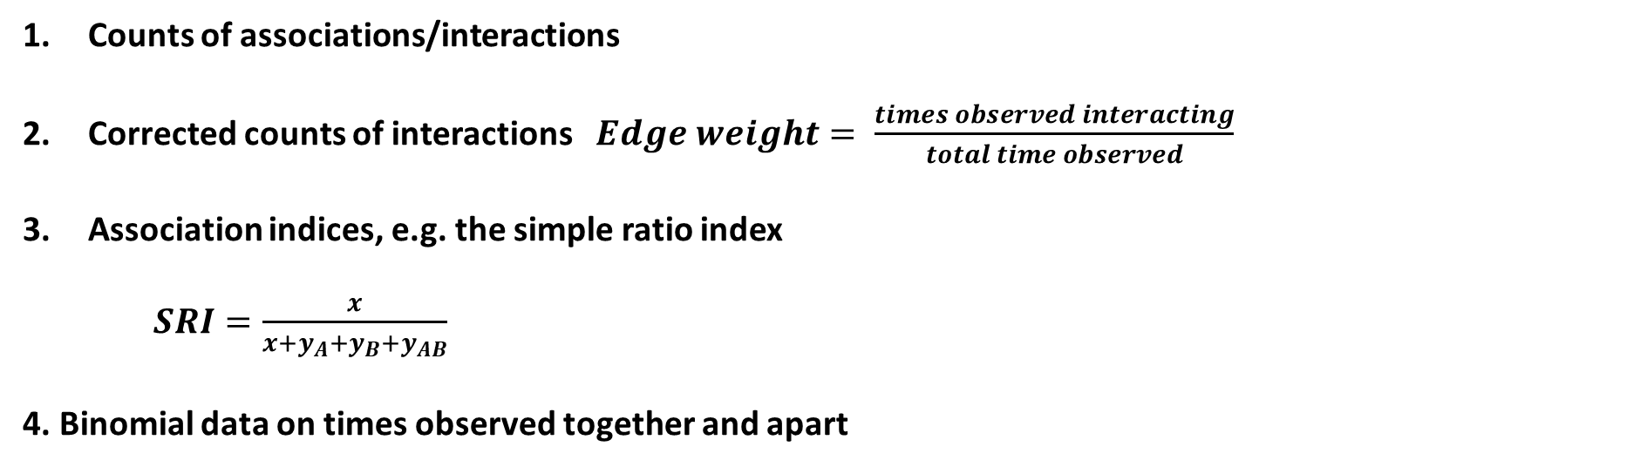
CEFE SOCIAL NETWORKS COURSE
Static network representations
There are lots of different ways to weight social network edges
Counts of associations/interactions
Corrected counts of interactions $Edge weight= \frac{times observed interacting}{total time observed}$
Association indices, e.g. the simple ratio index
$SRI=\frac{x}{x+y_{A}+y_{B}+y_{AB}}$
4. Binomial data on times observed together and apart
Lots of variations which are described here: https://doi.org/10.1016/j.anbehav.2017.08.029
Good description of why this is a good method: https://doi.org/10.1101/2021.12.20.473541

Slide 30
CEFE SOCIAL NETWORKS COURSE
Static network representations
An alternative to using weighted networks is to use multigraphs
Sometimes the number of strength of interactions/associations provide different information
ID 1 | ID 2 | Attribute
1 | 2 | 3
1 | 3 | 1
1 | 6 | 1
2 | 4 | 1
3 | 4 | 1
3 | 5 | 1
5 | 6 | 2
5 | 7 | 2
6 | 7 | 2
7 | 8 | 1
 | 1 | 2 | 3 | 4 | 5 | 6 | 7 | 8
1 | 0 | 3 | 1 | 0 | 0 | 1 | 0 | 0
2 | 3 | 0 | 0 | 1 | 0 | 0 | 0 | 0
3 | 1 | 0 | 0 | 1 | 1 | 0 | 0 | 0
4 | 0 | 1 | 1 | 0 | 0 | 0 | 0 | 0
5 | 0 | 0 | 1 | 0 | 0 | 2 | 2 | 0
6 | 1 | 0 | 0 | 0 | 2 | 0 | 2 | 0
7 | 0 | 0 | 0 | 0 | 2 | 2 | 0 | 1
8 | 0 | 0 | 0 | 0 | 0 | 0 | 1 | 0
1
2
3
4
5
6
7
8

Slide 31
CEFE SOCIAL NETWORKS COURSE
Static network representations
So when might you want to use weighted networks versus multigraphs?
The distinction between weighted networks and multigraphs is most useful when both their number/frequency and duration are important.
Considering multigraphs can also be helpful when designing permutation procedures for analysing the networks.

Slide 32
CEFE SOCIAL NETWORKS COURSE
Static network representations
You can also create directed networks
ID 1 | ID 2 | Attribute
1 | 2 | 3
1 | 3 | 1
2 | 4 | 1
3 | 5 | 1
4 | 3 | 1
5 | 7 | 2
6 | 1 | 1
6 | 5 | 2
6 | 7 | 2
7 | 8 | 1
 | 1 | 2 | 3 | 4 | 5 | 6 | 7 | 8
1 | 0 | 3 | 0 | 0 | 0 | 0 | 0 | 0
2 | 0 | 0 | 0 | 1 | 0 | 0 | 0 | 0
3 | 1 | 0 | 0 | 0 | 1 | 0 | 0 | 0
4 | 0 | 0 | 1 | 0 | 0 | 0 | 0 | 0
5 | 0 | 0 | 0 | 0 | 0 | 0 | 2 | 0
6 | 1 | 0 | 0 | 0 | 2 | 0 | 2 | 0
7 | 0 | 0 | 0 | 0 | 0 | 0 | 0 | 1
8 | 0 | 0 | 0 | 0 | 0 | 0 | 0 | 0
1
2
3
4
5
6
7
8

Slide 33
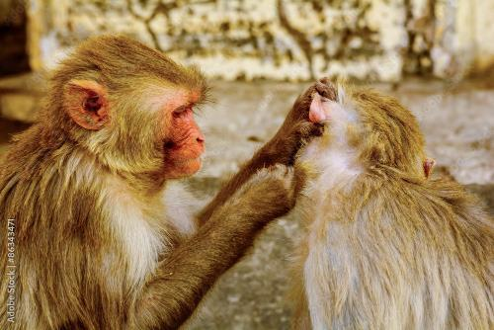

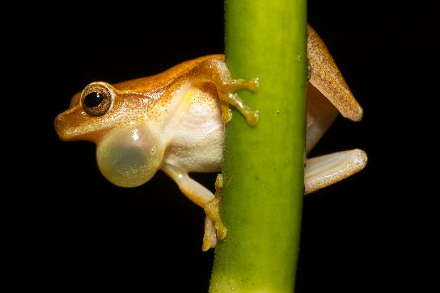
CEFE SOCIAL NETWORKS COURSE
Static network representations
You can also create directed networks
1
2
3
4
5
6
7
8

Slide 34
CEFE SOCIAL NETWORKS COURSE
Static network representations
You can also create directed networks
1
2
3
4
5
6
7
Some network motifs like TRANSITIVE triads are a feature of animal dominance hierarchies
8

Slide 35
CEFE SOCIAL NETWORKS COURSE
Static network representations
With limited data or sampling power it can be helpful to think about ego networks

Slide 36
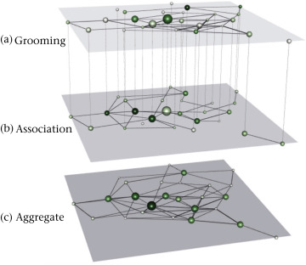
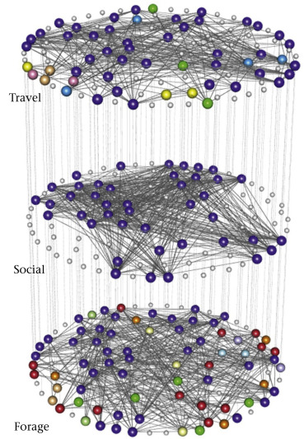
CEFE SOCIAL NETWORKS COURSE
Static network representations
Multilayer networks are a tool to represent multiple sets of interactions that depend on each other
Multiplex networks

Slide 37
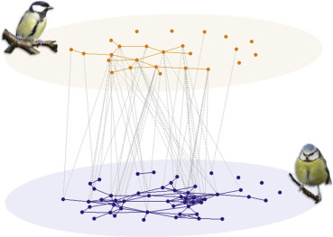
CEFE SOCIAL NETWORKS COURSE
Static network representations
Multilayer networks are a tool to represent multiple sets of interactions that depend on each other
Multiplex networks
Interconnected networks

Slide 38
CEFE SOCIAL NETWORKS COURSE
Static network representations
Multilayer networks are a tool to represent multiple sets of interactions that depend on each other
Important things to think about before using this representation:
Are my behaviours sufficiently different to represent as different layers?
Does one behaviour depend on another? (e.g. grooming requires proximity)
Can I scale edge weights and directions to make sense?
Multiplex networks

Slide 39
CEFE SOCIAL NETWORKS COURSE
Static network representations
Multilayer networks are a tool to represent multiple sets of interactions that depend on each other
 | 1 | 2 | 3 | 4 | 5 | 6 | 7 | 8
1 | 0 | 3 | 1 | 0 | 0 | 1 | 0 | 0
2 | 3 | 0 | 0 | 1 | 0 | 0 | 0 | 0
3 | 1 | 0 | 0 | 1 | 1 | 0 | 0 | 0
4 | 0 | 1 | 1 | 0 | 0 | 0 | 0 | 0
5 | 0 | 0 | 1 | 0 | 0 | 2 | 2 | 0
6 | 1 | 0 | 0 | 0 | 2 | 0 | 2 | 0
7 | 0 | 0 | 0 | 0 | 2 | 2 | 0 | 1
8 | 0 | 0 | 0 | 0 | 0 | 0 | 1 | 0
 | 1 | 2 | 3 | 4 | 5 | 6 | 7 | 8
1 | 0 | 2 | 0 | 1 | 0 | 2 | 0 | 0
2 | 2 | 0 | 0 | 1 | 0 | 0 | 0 | 0
3 | 0 | 0 | 0 | 0 | 3 | 1 | 0 | 0
4 | 1 | 3 | 1 | 0 | 1 | 0 | 0 | 0
5 | 0 | 1 | 3 | 1 | 0 | 4 | 1 | 0
6 | 2 | 0 | 1 | 0 | 4 | 0 | 3 | 2
7 | 0 | 0 | 0 | 0 | 1 | 3 | 0 | 1
8 | 0 | 0 | 0 | 0 | 0 | 2 | 1 | 0
ID 1 | ID 2 | Weight | Layer
1 | 2 | 3 | 1
1 | 3 | 1 | 1
1 | 6 | 1 | 1
2 | 4 | 1 | 1
3 | 4 | 1 | 1
3 | 5 | 1 | 1
5 | 6 | 2 | 1
5 | 7 | 2 | 1
6 | 7 | 2 | 1
7 | 8 | 1 | 1
Multiplex networks

Slide 40
CEFE SOCIAL NETWORKS COURSE
Static network representations
Multilayer networks are a tool to represent multiple sets of interactions that depend on each other
 | A1 | A2 | A3 | A4 | B1 | B2 | B3 | B4
A1 | 0 | 3 | 1 | 0 | 0 | 1 | 0 | 0
A2 | 3 | 0 | 0 | 1 | 0 | 0 | 0 | 0
A3 | 1 | 0 | 0 | 1 | 1 | 0 | 0 | 0
A4 | 0 | 1 | 1 | 0 | 0 | 0 | 0 | 0
B1 | 0 | 0 | 1 | 0 | 0 | 2 | 2 | 0
B2 | 1 | 0 | 0 | 0 | 2 | 0 | 2 | 0
B3 | 0 | 0 | 0 | 0 | 2 | 2 | 0 | 1
B4 | 0 | 0 | 0 | 0 | 0 | 0 | 1 | 0
Interlayer edges
Intralayer edges
Supra-adjacency matrix
Interconnected networks

Slide 41
CEFE SOCIAL NETWORKS COURSE
Static network representations
Multilayer networks are a tool to represent multiple sets of interactions that depend on each other
 | 1A | 2A | 3A | 4A | 1B | 2B | 3B | 4B
1A | 0 | 3 | 1 | 0 | 1 | 0 | 0 | 0
2A | 3 | 0 | 0 | 1 | 0 | 1 | 0 | 0
3A | 1 | 0 | 0 | 1 | 0 | 0 | 1 | 0
4A | 0 | 1 | 1 | 0 | 0 | 0 | 0 | 1
1B | 1 | 0 | 0 | 0 | 0 | 2 | 2 | 0
2B | 0 | 1 | 0 | 0 | 2 | 0 | 2 | 0
3B | 0 | 0 | 1 | 0 | 2 | 2 | 0 | 1
4B | 0 | 0 | 0 | 1 | 0 | 0 | 1 | 0
Interlayer edges
Intralayer edges
Supra-adjacency matrix
Multiplex network

Slide 42
CEFE SOCIAL NETWORKS COURSE
Static network representations
Bipartite networks are a tool to represent interactions between different types of node
Resource use networks

Slide 43
CEFE SOCIAL NETWORKS COURSE
Static network representations
Bipartite networks are a tool to represent interactions between different types of node
Resource use networks
Mating networks

Slide 44
CEFE SOCIAL NETWORKS COURSE
Static network representations
Bipartite networks are a tool to represent interactions between different types of node
Places
1
2
3
4
5
6
7
8
9
10
Individuals | 2 | 3 | 4 | 5 | 6 | 7 | 8
1 | 2 | 3 | 4 | 5 | 6 | 7 | 8
1 | 1 | 0 | 0 | 1 | 0 | 0 | 0
1 | 0 | 1 | 0 | 0 | 0 | 0 | 0
1 | 0 | 0 | 0 | 0 | 0 | 0 | 0
0 | 1 | 0 | 1 | 1 | 1 | 1 | 0
0 | 0 | 1 | 1 | 0 | 0 | 0 | 1
0 | 0 | 1 | 0 | 0 | 0 | 0 | 0
0 | 0 | 0 | 0 | 1 | 1 | 0 | 0
0 | 0 | 0 | 0 | 1 | 0 | 0 | 0
0 | 0 | 0 | 0 | 0 | 1 | 1 | 0
0 | 0 | 0 | 0 | 0 | 0 | 1 | 1
Can be represented using an INCIDENCE MATRIX

Slide 45
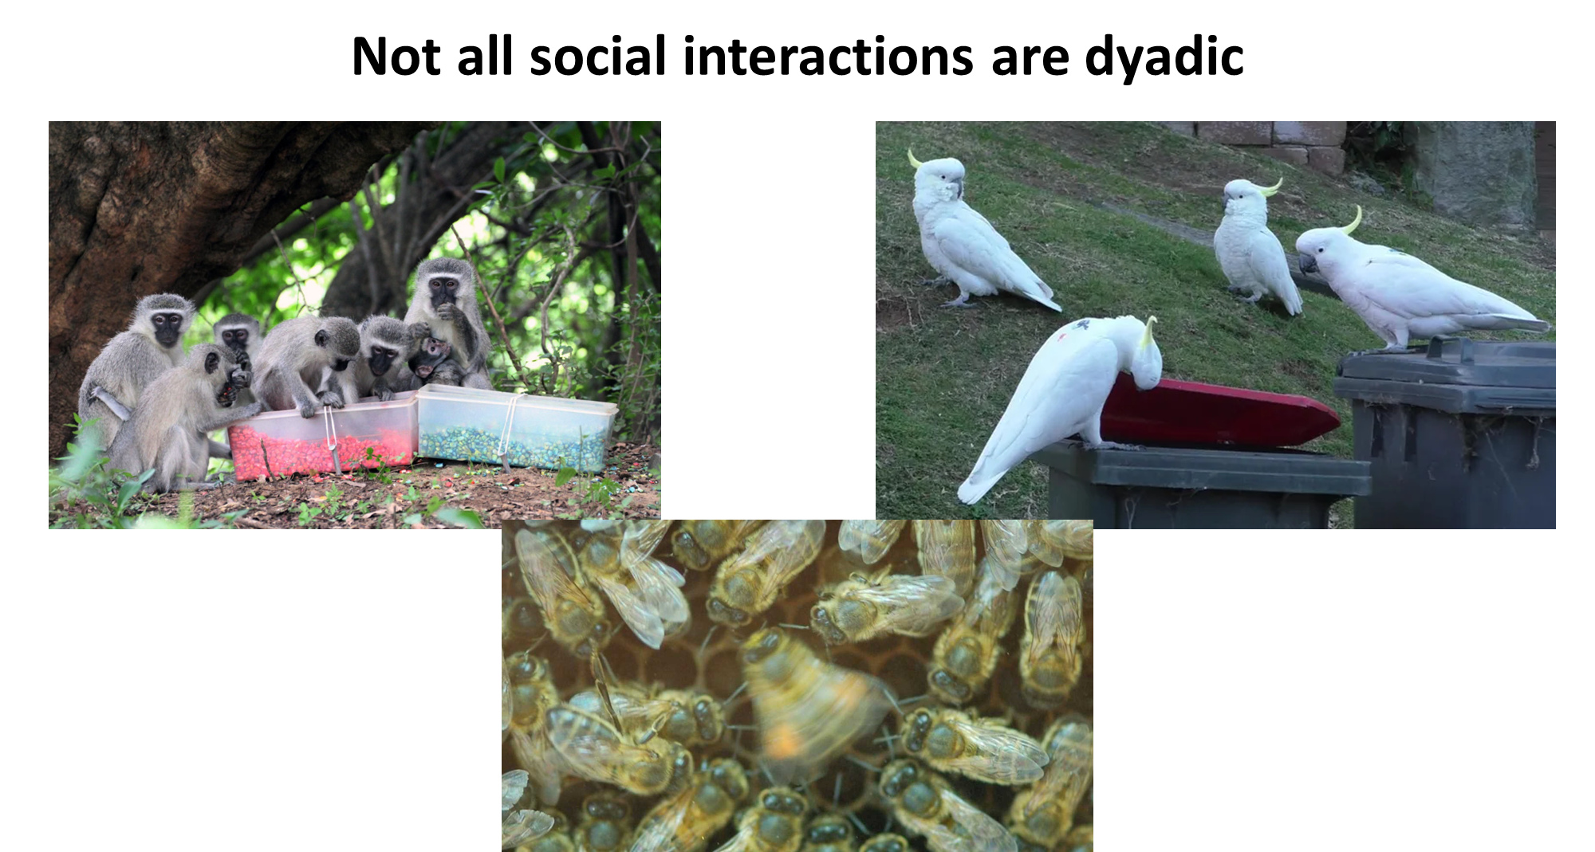
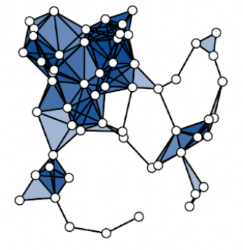
CEFE SOCIAL NETWORKS COURSE
Static network representations
Higher-order networks are a tool to represent interactions that can be between more than two individuals

Slide 46
CEFE SOCIAL NETWORKS COURSE
Static network representations
Higher-order networks are a tool to represent interactions that can be between more than two individuals

Slide 47
CEFE SOCIAL NETWORKS COURSE
Static network representations
Higher-order networks are a tool to represent interactions that can be between more than two individuals
Higher-order networks let us include information on the size of interactions.
An “edge” can now connect more than two individuals at a time.
Simplest type of higher-order is the HYPERGRAPH in which nodes are connected by hyperedges

Slide 48
CEFE SOCIAL NETWORKS COURSE
Static network representations
Higher-order networks are a tool to represent interactions that can be between more than two individuals
Hyperedges
1
2
3
4
5
6
7
8
Individuals | 2 | 3 | 4 | 5 | 6 | 7 | 8
1 | 2 | 3 | 4 | 5 | 6 | 7 | 8 | 9 | 10
1 | 1 | 0 | 0 | 0 | 0 | 0 | 0 | 0 | 0
1 | 1 | 1 | 1 | 1 | 0 | 0 | 0 | 0 | 0
0 | 0 | 1 | 1 | 0 | 0 | 0 | 0 | 0 | 0
0 | 0 | 0 | 0 | 1 | 1 | 0 | 0 | 0 | 0
0 | 0 | 0 | 0 | 0 | 1 | 1 | 1 | 0 | 0
0 | 0 | 0 | 0 | 0 | 0 | 1 | 0 | 1 | 0
0 | 0 | 0 | 0 | 0 | 0 | 0 | 1 | 0 | 1
0 | 0 | 0 | 0 | 0 | 0 | 0 | 0 | 1 | 1
9
7
10
8
6
2
5
1
4
3
Can be represented using an INCIDENCE MATRIX

Slide 49
CEFE SOCIAL NETWORKS COURSE
Dynamic network representations
We may also need to represent the temporal dynamics of networks
All network data starts with a temporal component
Most efficiently stored as edge lists
We have to decide:
If it is important to include?
How to include it?
ID 1 | ID 2 | Weight | Time
1 | 2 | 3 | 01/01/2023 07:45
1 | 3 | 1 | 01/01/2023 07:49
1 | 6 | 1 | 03/01/2023 10:18
2 | 4 | 1 | 01/01/2023 07:59
3 | 4 | 1 | 01/01/2023 11:47
3 | 5 | 1 | 02/01/2023 15:32
5 | 6 | 2 | 02/01/2023 09:46
5 | 7 | 2 | 02/01/2023 16:02
6 | 7 | 2 | 01/01/2023 08:30
7 | 8 | 1 | 04/01/2023 12:35

Slide 50
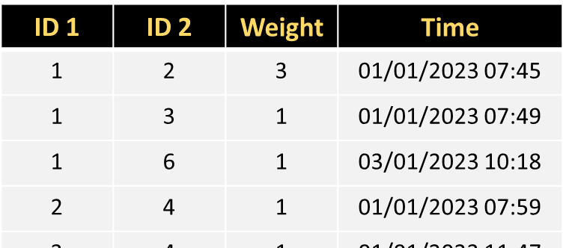
CEFE SOCIAL NETWORKS COURSE
Dynamic network representations
We may also need to represent the temporal dynamics of networks
We have to decide:
2) How to include it?
TIME-ORDERED NETWORKS
TIME-AGGREGATED NETWORKS
t=1
t=2
t=3

Slide 51
CEFE SOCIAL NETWORKS COURSE
Dynamic network representations
We may also need to represent the temporal dynamics of networks
TIME-ORDERED NETWORKS
Retain the most information about the system
Fewer subjective decisions required
Harder to work with – few descriptive measures and models are available

Slide 52
CEFE SOCIAL NETWORKS COURSE
Dynamic network representations
We may also need to represent the temporal dynamics of networks
Adopts same data structures and models as static networks
More statistical tools available
Need to decide how to aggregate the social data
Snapshots (single moment in time)
Aggregate over biologically justified timescales
Rolling windows (e.g. months 1-3, months 2-4 etc.)
TIME-AGGREGATED NETWORKS
t=1
t=2
t=3

Slide 53
CEFE SOCIAL NETWORKS COURSE
Different network representations
1. Go to the R Markdown for Session 1 and work through the section SESSION 1: PART 6

Slide 54
CEFE SOCIAL NETWORKS COURSE
Plan for the next two weeks:
03/04/2023 – What is a network?
TODAY - How do we describe network structures?
13/04/2023 - How do we test hypotheses in networks?
14/04/2023 - Extend our network skillset
Course materials: https://github.com/NETDEM-project/CEFE_Networks_Course

Slide 55
CEFE SOCIAL NETWORKS COURSE
Plan for today:
The basics of network structure
Describing node-level or microscale structure of networks
Describing mesoscale structure of networks
Describing macroscale structure of networks

Slide 56
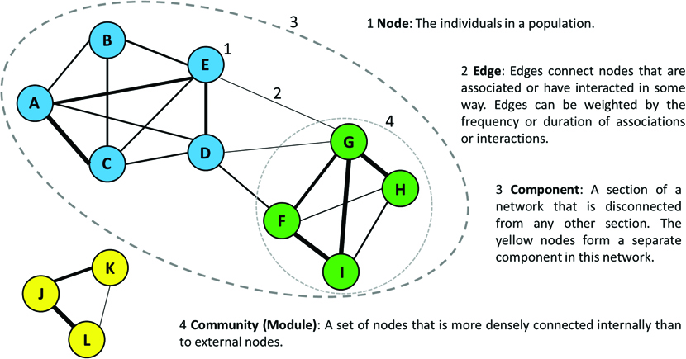
CEFE SOCIAL NETWORKS COURSE
The basics of network structure

Slide 57
CEFE SOCIAL NETWORKS COURSE
2. Describing microscale structure of networks
We can use network measures of network metrics to quantify an individual’s social network position. These measures are mainly:
CENTRALITY measures that capture how “central” or influential an individual is in the network.
However, there are other measures that capture other aspects of an individual’s social network position such as:
CLUSTERING COEFFICIENT
EDGE WEIGHT VARIANCE

Slide 58
CEFE SOCIAL NETWORKS COURSE
2. Describing microscale structure of networks
There are MANY CENTRALITY measures
We will introduce some here but it is not an exhaustive list
DEGREE is the number of connections a node has
igraph::degree(network)
Degree can be standardized by dividing by the number of nodes minus one

Slide 59
CEFE SOCIAL NETWORKS COURSE
2. Describing microscale structure of networks
There are MANY CENTRALITY measures
We will introduce some here but it is not an exhaustive list
DEGREE is the number of connections a node has
igraph::degree(network)
STRENGTH (WEIGHTED DEGREE) takes into account the weight of each edge
igraph::strength(network)

Slide 60
CEFE SOCIAL NETWORKS COURSE
2. Describing microscale structure of networks
There are MANY CENTRALITY measures
We will introduce some here but it is not an exhaustive list
DEGREE is the number of connections a node has
STRENGTH (WEIGHTED DEGREE) takes into account the weight of each edge
Degree and strength are LOCAL measures of centrality that take into account only immediate neighbours

Slide 61
CEFE SOCIAL NETWORKS COURSE
2. Describing microscale structure of networks
There are MANY CENTRALITY measures
We will introduce some here but it is not an exhaustive list
DEGREE is the number of connections a node has
STRENGTH (WEIGHTED DEGREE) takes into account the weight of each edge
Degree and strength are LOCAL measures of centrality that take into account only immediate neighbours
In directed networks you can calculate separate “in-” and “out-” versions of the measures

Slide 62
CEFE SOCIAL NETWORKS COURSE
2. Describing microscale structure of networks
There are MANY CENTRALITY measures
We will introduce some here but it is not an exhaustive list
EIGENVECTOR CENTRALITY
igraph::eigen_centrality(network)
Eigenvector centrality take into account a wider neighbourhood when measuring an individual’s centrality

Slide 63
CEFE SOCIAL NETWORKS COURSE
2. Describing microscale structure of networks
There are MANY CENTRALITY measures
We will introduce some here but it is not an exhaustive list
EIGENVECTOR CENTRALITY
igraph::eigen_centrality(network)
Eigenvector centrality take into account a wider neighbourhood when measuring an individual’s centrality
There are additional, slightly modified variations of eigenvector centrality
igraph::page_rank(network)

Slide 64
CEFE SOCIAL NETWORKS COURSE
2. Describing microscale structure of networks
There are MANY CENTRALITY measures
We will introduce some here but it is not an exhaustive list
BETWEENNESS measures how many shortest paths an individual lies on
igraph::betweenness(network)
High
Medium
Low

Slide 65
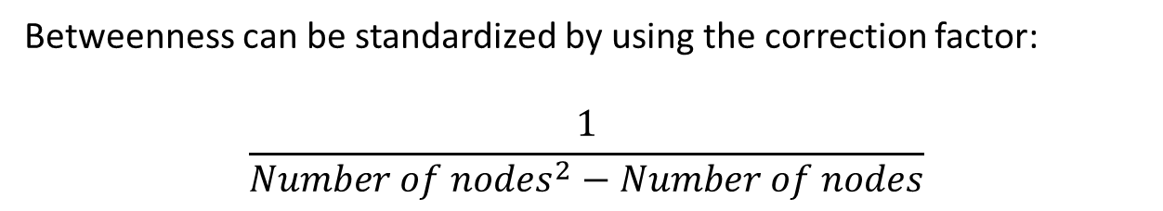
CEFE SOCIAL NETWORKS COURSE
2. Describing microscale structure of networks
Edges can have betweenness centrality scores too!
There are MANY CENTRALITY measures
We will introduce some here but it is not an exhaustive list
BETWEENNESS measures how many shortest paths an individual lies on
igraph::betweenness(network)
Betweenness can be standardized by using the correction factor:
$$\frac{1}{{Number of nodes}^{2}−Number of nodes}$$
High
Medium
Low

Slide 66
CEFE SOCIAL NETWORKS COURSE
2. Describing microscale structure of networks
There are MANY CENTRALITY measures
We will introduce some here but it is not an exhaustive list
BETWEENNESS measures how many shortest paths an individual lies on
CLOSENESS measures who has the shortest paths on average to other nodes
High
Medium
Low
igraph::closeness(network)

Slide 67
CEFE SOCIAL NETWORKS COURSE
2. Describing microscale structure of networks
There are MANY CENTRALITY measures
We will introduce some here but it is not an exhaustive list
BETWEENNESS measures how many shortest paths an individual lies on
CLOSENESS measures who has the shortest paths on average to other nodes
High
Medium
Low
Betweenness and closeness are GLOBAL measures of centrality that take into account only immediate neighbours

Slide 68
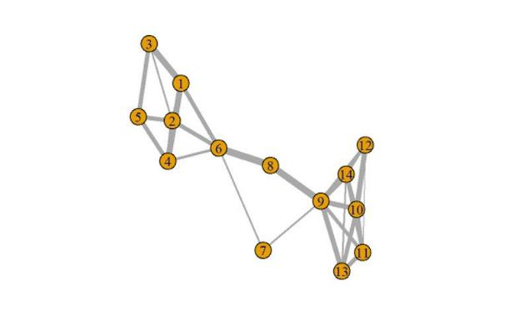
CEFE SOCIAL NETWORKS COURSE
2. Describing microscale structure of networks
An important note on calculating betweenness and closeness in igraph
https://twitter.com/mattjsilk/status/997029135548669957
By default in shortest paths calculations igraph treats edge weights as costs
This is not a sensible option for most social networks
So we MUST manually specify edge weights in the calculation or use tnet (where this is done automatically)
7
8

Slide 69
CEFE SOCIAL NETWORKS COURSE
2. Describing microscale structure of networks
There are MANY CENTRALITY measures
We will introduce some here but it is not an exhaustive list
BETWEENNESS measures how many shortest paths an individual lies on
CLOSENESS measures who has the shortest paths on average to other nodes
High
Medium
Low
FLOW BETWEENNESS is an alternative global measure that quantifies “information flow” through a node
sna::flowbet(adjacency_matrix)

Slide 70
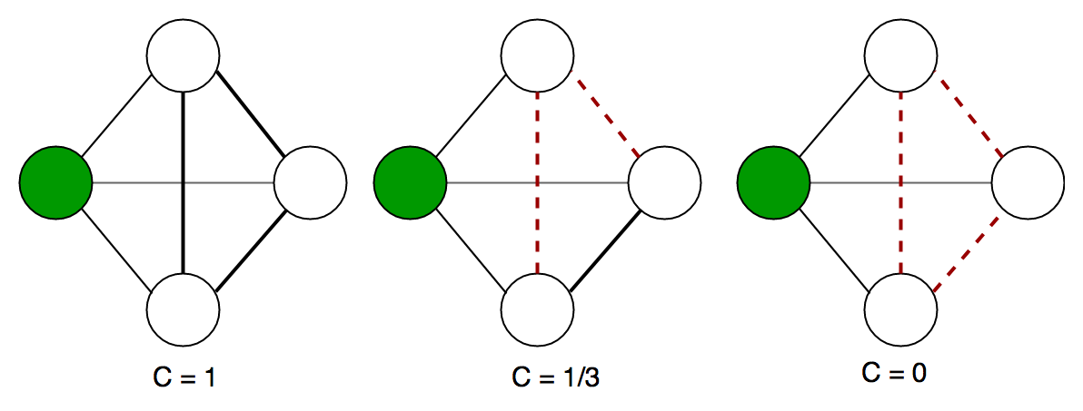
CEFE SOCIAL NETWORKS COURSE
2. Describing microscale structure of networks
A quick overview of the other measures…
CLUSTERING COEFFICIENT measures if a focal node’s connections also tend to be connected with each other

Slide 71
CEFE SOCIAL NETWORKS COURSE
2. Describing microscale structure of networks
A quick overview of the other measures…
CLUSTERING COEFFICIENT measures if a focal node’s connections also tend to be connected with each other
EDGE WEIGHT VARIANCE measures how differentiated an individual’s social connections are

Slide 72
CEFE SOCIAL NETWORKS COURSE
2. Describing microscale structure of networks
A quick overview of the other measures…
CLUSTERING COEFFICIENT measures if a focal node’s connections also tend to be connected with each other
EDGE WEIGHT VARIANCE measures how differentiated an individual’s social connections are
These measures can tell us about how socially embedded an individual is, which may be important in assessing social integration in a group

Slide 73
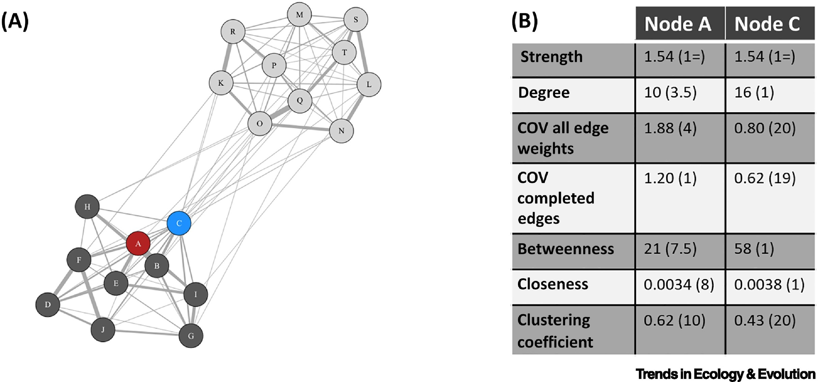
CEFE SOCIAL NETWORKS COURSE
2. Describing microscale structure of networks
Using multiple social network measures can tell us more about an individual’s social network position than just picking one

Slide 74
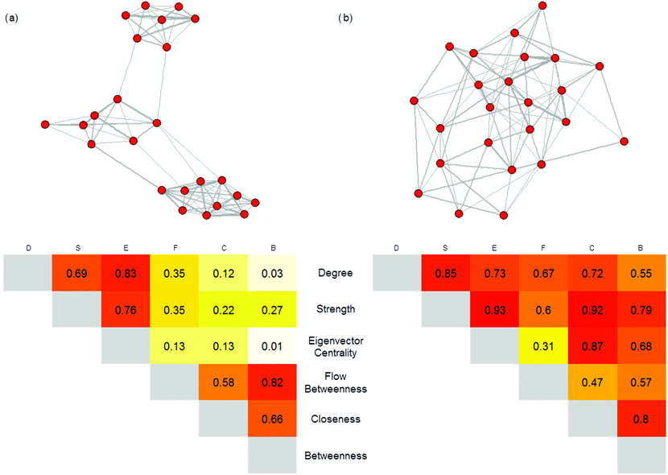
CEFE SOCIAL NETWORKS COURSE
2. Describing microscale structure of networks
Using multiple social network measures can tell us more about an individual’s social network position than just picking one
BUT the correlation between different centrality measures can depend on the network structure

Slide 75
CEFE SOCIAL NETWORKS COURSE
2. Describing microscale structure of networks
1. Go to the R Markdown for Session 2 and work through the section SESSION 2: PART 2
Calculate the correlation between network measures for
A random network
A small-world network
The network from the full_adj adjacency matrix
Another network that you generate
See if you can work out what the correlations might be before calculating them in the different networks

Slide 76
CEFE SOCIAL NETWORKS COURSE
3. Describing mesoscale structure of networks
It might also be important to identify the structure of neighbourhoods within networks as they could have important ecological and evolutionary consequences
We are going to talk about four main features here:
Triads
Cliques
Community Structure
Core-periphery structure

Slide 77
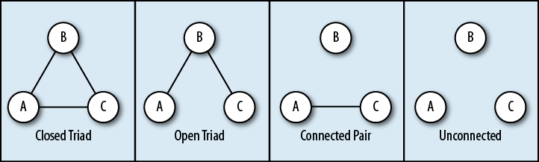
CEFE SOCIAL NETWORKS COURSE
3. Describing mesoscale structure of networks
TRIADS
A triad census of a network can tell us lots about its structure

Slide 78
CEFE SOCIAL NETWORKS COURSE
3. Describing mesoscale structure of networks
TRIADS
The structural balance of triads can be important in network formation and dynamics.

Slide 79
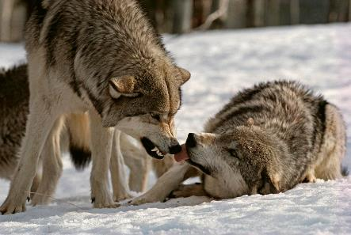
CEFE SOCIAL NETWORKS COURSE
3. Describing mesoscale structure of networks
TRIADS
In directed networks transitive and cyclical triads can tell us about network structure
5
5
6
6
7
7
TRANSITIVE
CYCLICAL
The proportion of transitive and cyclical triads can tell us a lot about animal dominance hierarchies

Slide 80
CEFE SOCIAL NETWORKS COURSE
3. Describing mesoscale structure of networks
CLIQUES
**Cliques are not the same as communities/clusters in social network terminology**
Clique 1
A clique is a maximal complete subgraph
i.e. you can’t add any more nodes to it without it no longer being complete – all nodes connected to all others
Cliques in networks could vary in size
They often overlap
Clique 2

Slide 81
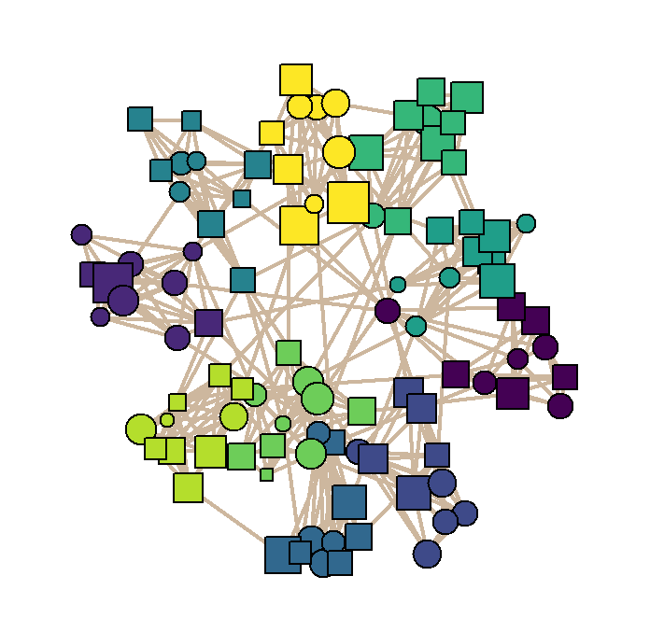
CEFE SOCIAL NETWORKS COURSE
3. Describing mesoscale structure of networks
COMMUNITY STRUCTURE
Some networks are divided into clusters which have more edges within clusters than between them.
These are called modules or communities
Community structure can be important for ecological processes such as disease transmission

Slide 82
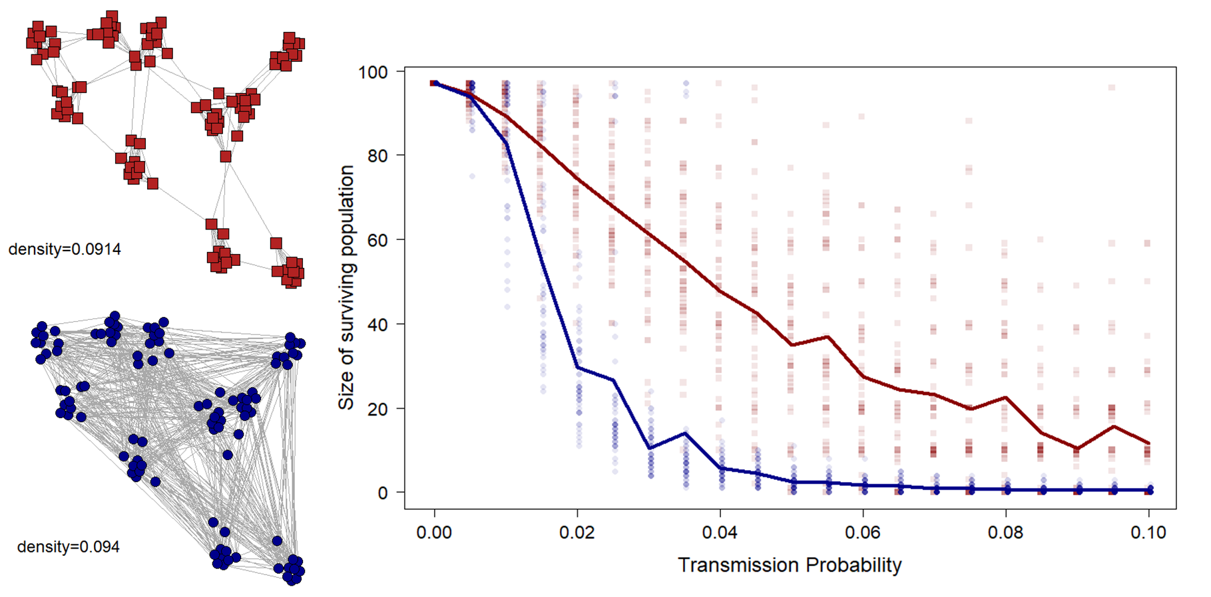
CEFE SOCIAL NETWORKS COURSE
3. Describing mesoscale structure of networks
COMMUNITY STRUCTURE

Slide 83
CEFE SOCIAL NETWORKS COURSE
3. Describing mesoscale structure of networks
COMMUNITY STRUCTURE
There are two routes to finding community structure:
Community detection algorithms
Statistical models called stochastic block models
We will introduce community detection algorithms here as a descriptive tool but be warned that they need to be used carefully, as using statistical models is better for formal analysis of communities
https://skewed.de/tiago/blog/descriptive-inferential

Slide 84
CEFE SOCIAL NETWORKS COURSE
3. Describing mesoscale structure of networks
COMMUNITY STRUCTURE
There are two routes to finding community structure:
Community detection algorithms
There are MANY community detection algorithms:
https://igraph.org/c/doc/igraph-Community.html
They won’t always give the same results
It can be difficult to decide which is best – read the help pages carefully for clues

Slide 85
CEFE SOCIAL NETWORKS COURSE
3. Describing mesoscale structure of networks
COMMUNITY STRUCTURE
There are two routes to finding community structure:
Community detection algorithms
There are MANY community detection algorithms:
https://igraph.org/c/doc/igraph-Community.html
They won’t always give the same results
It can be difficult to decide which is best – read the help pages carefully for clues
The infomap algorithm is often a good place to start

Slide 86
CEFE SOCIAL NETWORKS COURSE
3. Describing mesoscale structure of networks
COMMUNITY STRUCTURE
There are two routes to finding community structure:
Community detection algorithms
Most community detection methods maximise MODULARITY
Modularity is a measure of the strength of division of a network into the assigned groups
High modularity indicates many more connections within groups than expected by chance

Slide 87
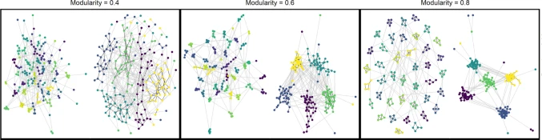
CEFE SOCIAL NETWORKS COURSE
3. Describing mesoscale structure of networks
COMMUNITY STRUCTURE

Slide 88

CEFE SOCIAL NETWORKS COURSE
3. Describing mesoscale structure of networks
CORE-PERIPHERY STRUCTURE
Core-periphery structure can help “insiders” and “outsiders” in social groups
In igraph:
igraph::coreness(network)
Or you can use specific R packages:
https://rdrr.io/github/schochastics/igraphUtils/
Not used commonly in animal social network analysis
CORE

Slide 89
CEFE SOCIAL NETWORKS COURSE
3. Describing mesoscale structure of networks
Go to the R Markdown for Session 2 and work through the section SESSION 2: PART 3

Slide 90
CEFE SOCIAL NETWORKS COURSE
4. Describing macroscale structure of networks
There are also a wide range of measures to describe the structure of the network as a whole.
I will provide an overview of the most commonly used and/or useful here

Slide 91
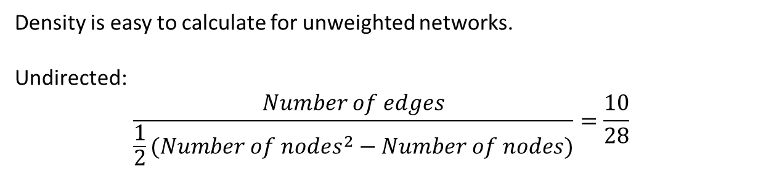
CEFE SOCIAL NETWORKS COURSE
4. Describing macroscale structure of networks
There are also a wide range of measures to describe the structure of the network as a whole.
I will provide an overview of the most commonly used and/or useful here
DENSITY (sometimes called connectance for ecological networks) is the proportion of possible edges that are connected
Density is easy to calculate for unweighted networks.
Undirected:
$$\frac{Number of edges}{{\frac{1}{2}(Number of nodes}^{2}−Number of nodes)}=\frac{10}{28}$$

Slide 92
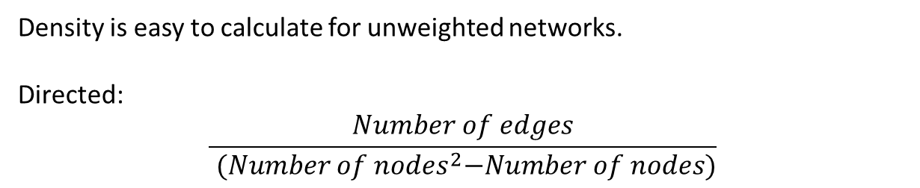
CEFE SOCIAL NETWORKS COURSE
4. Describing macroscale structure of networks
There are also a wide range of measures to describe the structure of the network as a whole.
I will provide an overview of the most commonly used and/or useful here
DENSITY (sometimes called connectance for ecological networks) is the proportion of possible edges that are connected
Density is easy to calculate for unweighted networks.
Directed:
$$\frac{Number of edges}{{ (Number of nodes}^{2}−Number of nodes)}$$

Slide 93
CEFE SOCIAL NETWORKS COURSE
4. Describing macroscale structure of networks
There are also a wide range of measures to describe the structure of the network as a whole.
I will provide an overview of the most commonly used and/or useful here
DENSITY (sometimes called connectance for ecological networks) is the proportion of possible edges that are connected
Density is easy to calculate in igraph
igraph::edge_density(network)

Slide 94
CEFE SOCIAL NETWORKS COURSE
4. Describing macroscale structure of networks
There are also a wide range of measures to describe the structure of the network as a whole.
I will provide an overview of the most commonly used and/or useful here
DENSITY (sometimes called connectance for ecological networks) is the proportion of possible edges that are connected
Networks with high density are more efficient – better at spreading information but more susceptible to disease outbreaks

Slide 95
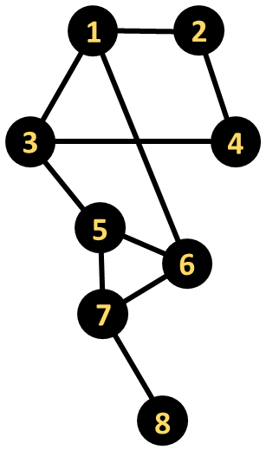
CEFE SOCIAL NETWORKS COURSE
4. Describing macroscale structure of networks
There are also a wide range of measures to describe the structure of the network as a whole.
I will provide an overview of the most commonly used and/or useful here
AVERAGE PATH LENGTH is the average shortest route (in terms of number of edges traversed) between all possible pairs of nodes in the network
1—2: path length = 1
1—3: path length = 1
1—4: path length = 2
1—5: path length = 2
1—6: path length = 1
1—7: path length = 2
1—8: path length = 3
You can calculate average path length in igraph
igraph::mean_distance(network)

Slide 96
CEFE SOCIAL NETWORKS COURSE
4. Describing macroscale structure of networks
There are also a wide range of measures to describe the structure of the network as a whole.
I will provide an overview of the most commonly used and/or useful here
AVERAGE PATH LENGTH is the average shortest route (in terms of number of edges traversed) between all possible pairs of nodes in the network
1—2: path length = 1
1—3: path length = 1
1—4: path length = 2
1—5: path length = 2
1—6: path length = 1
1—7: path length = 2
1—8: path length = 3
You can calculate average path length in igraph
igraph::mean_distance(network)
BUT in weighted networks you have to remember to convert edge weights again so that the weights are not treated as costs

Slide 97
CEFE SOCIAL NETWORKS COURSE
4. Describing macroscale structure of networks
There are also a wide range of measures to describe the structure of the network as a whole.
I will provide an overview of the most commonly used and/or useful here
GLOBAL EFFICIENCY is the average of inverse distances between all pairs of nodes.
1—2: inverse path length = 1
1—3: inverse path length = 1
1—4: inverse path length = 1/2
1—5: inverse path length = 1/2
1—6: inverse path length = 1
1—7: inverse path length = 1/2
1—8: inverse path length = 1/3
You can calculate efficiency length in igraph
igraph::global_efficiency(network)
BUT in weighted networks you have to remember to convert edge weights again so that the weights are not treated as costs

Slide 98
CEFE SOCIAL NETWORKS COURSE
4. Describing macroscale structure of networks
There are also a wide range of measures to describe the structure of the network as a whole.
I will provide an overview of the most commonly used and/or useful here
GLOBAL EFFICIENCY is the average of inverse distances between all pairs of nodes.
1—2: inverse path length = 1
1—3: inverse path length = 1
1—4: inverse path length = 1/2
1—5: inverse path length = 1/2
1—6: inverse path length = 1
1—7: inverse path length = 1/2
1—8: inverse path length = 1/3
You can calculate efficiency length in igraph
igraph::global_efficiency(network)
Efficiency can be useful in understanding transmission speeds through social networks

Slide 99
CEFE SOCIAL NETWORKS COURSE
4. Describing macroscale structure of networks
There are also a wide range of measures to describe the structure of the network as a whole.
I will provide an overview of the most commonly used and/or useful here
NODE-LEVEL METRIC DISTRIBUTIONS can also provide useful information about the network
Mean values
Coefficient of variation
Full metric distributions
For example, the degree distribution of a network is a key part of calculating the R₀ of a pathogen spreading across it

Slide 100
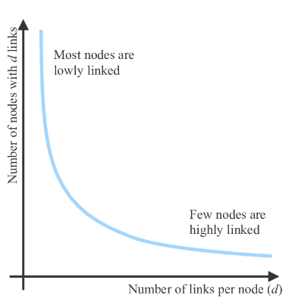
CEFE SOCIAL NETWORKS COURSE
4. Describing macroscale structure of networks
There are also a wide range of measures to describe the structure of the network as a whole.
I will provide an overview of the most commonly used and/or useful here
NODE-LEVEL METRIC DISTRIBUTIONS can also provide useful information about the network
The degree distribution can be calculated in igraph using
igraph::degree_distribution(network)
A power law degree distribution is a feature of some social networks that are highly centralized (or scale-free*)
*approximately at least

Slide 101
CEFE SOCIAL NETWORKS COURSE
4. Describing macroscale structure of networks
Go to the R Markdown for Session 2 and work through the section SESSION 2: PART 4

Slide 102
CEFE SOCIAL NETWORKS COURSE
Plan for the next two weeks:
03/04/2023 – What is a network?
06/04/2023 - How do we describe network structures?
TODAY - How do we test hypotheses in networks?
14/04/2023 - Extend our network skillset
Course materials: https://github.com/NETDEM-project/CEFE_Networks_Course

Slide 103
CEFE SOCIAL NETWORKS COURSE
Plan for today:
The challenges of social network analysis
Is my network important? Comparing networks to reference models
Nodal regressions: using network measures to explain other traits
Nodal regressions: asking what explains network position
Dyadic regressions
Comparing networks

Slide 104
CEFE SOCIAL NETWORKS COURSE
The challenges of social network analysis
There are various challenges that can make statistical modelling of networks complicated
Non-independence
Non-independence among the network position of different individuals

Slide 105
CEFE SOCIAL NETWORKS COURSE
The challenges of social network analysis
There are various challenges that can make statistical modelling of networks complicated
Non-independence
Non-independence among the network position of different individuals
Non-independence among edges (or social relationships)

Slide 106
CEFE SOCIAL NETWORKS COURSE
The challenges of social network analysis
There are various challenges that can make statistical modelling of networks complicated
Non-independence
Non-independence among the network position of different individuals
Non-independence among edges (or social relationships)
Covariance among network neighbours

Slide 107
CEFE SOCIAL NETWORKS COURSE
The challenges of social network analysis
There are various challenges that can make statistical modelling of networks complicated
Non-independence
Non-independence among the network position of different individuals
Non-independence among edges (or social relationships)
Covariance among network neighbours
Sensitivity to missing data

Slide 108
CEFE SOCIAL NETWORKS COURSE
The challenges of social network analysis
What happens if I remove some individuals from this network?
- The centrality of different individuals changes (especially for global centrality measures)
- Centrality measures are now less accurate

Slide 109
CEFE SOCIAL NETWORKS COURSE
The challenges of social network analysis
What happens if I remove some individuals from this network?
- The centrality of different individuals changes (especially for global centrality measures)
- Centrality measures are now less accurate
What happens if a new edge forms in the network?
- Are closely connected nodes also likely to form new social connections?

Slide 110
CEFE SOCIAL NETWORKS COURSE
The challenges of social network analysis
How do network neighbours affect each others trait values?

Slide 111
CEFE SOCIAL NETWORKS COURSE
The challenges of social network analysis
How do network neighbours affect each others trait values?
- Positive covariance (e.g. group traits, affiliative interactions)

Slide 112
CEFE SOCIAL NETWORKS COURSE
The challenges of social network analysis
How do network neighbours affect each others trait values?
- Positive covariance (e.g. group traits, affiliative interactions)
- Negative covariance (e.g. dominance)

Slide 113

CEFE SOCIAL NETWORKS COURSE
2. Is my network important? Comparing networks to reference models
What is a reference (or null) model?
Construct a distribution of alternative networks differing from your empirical network in a set of key features
Use a selected test statistic to see if your empirical network lies outside the distribution of the reference model
vs.

Slide 114
CEFE SOCIAL NETWORKS COURSE
2. Is my network important? Comparing networks to reference models
What is a reference (or null) model?
Construct a distribution of alternative networks differing from your empirical network in a set of key features
Use a selected test statistic to see if your empirical network lies outside the distribution of the reference model
vs.
Reference models have a place in animal social network analysis but are not the universal tool they have sometimes previously been treated as

Slide 115
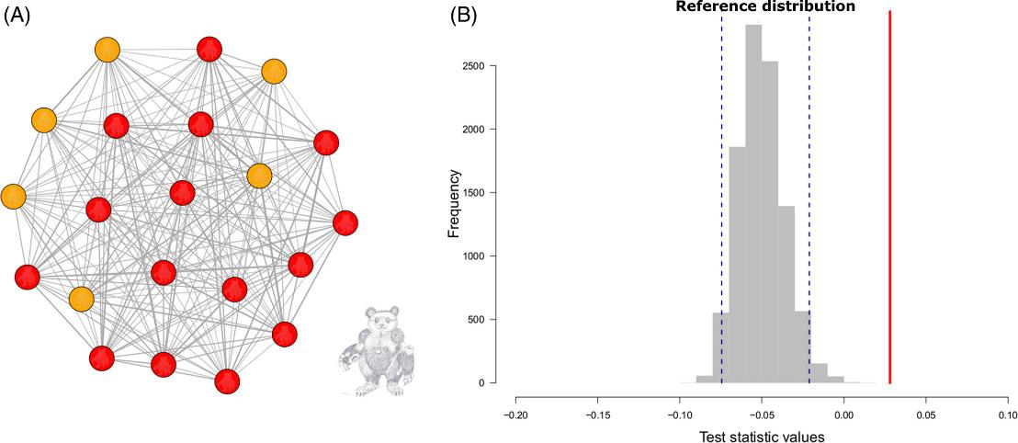
CEFE SOCIAL NETWORKS COURSE
2. Is my network important? Comparing networks to reference models
What is a reference (or null) model?
Construct a distribution of alternative networks differing from your empirical network in a set of key features
Use a selected test statistic to see if your empirical network lies outside the distribution of the reference model
Does assortativity between colours differ from that expected by chance?
Reference models have a place in animal social network analysis but are not the universal tool they have sometimes previously been treated as

Slide 116
CEFE SOCIAL NETWORKS COURSE
2. Is my network important? Comparing networks to reference models
How can I construct a reference model?
The key stages are:
Articulate the research question and specify the feature(s) of the reference model to be randomized
Choose a test statistic
Generate a reference distribution
Evaluate the process and adjust the reference model approach as needed
Reference models have a place in animal social network analysis but are not the universal tool they have sometimes previously been treated as

Slide 117
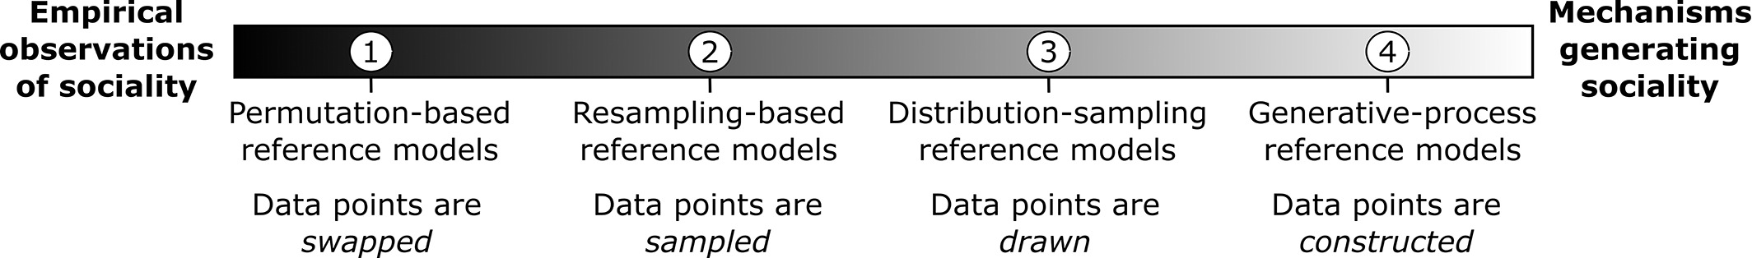
CEFE SOCIAL NETWORKS COURSE
2. Is my network important? Comparing networks to reference models
How can I generate a reference distribution?
Reference models have a place in animal social network analysis but are not the universal tool they have sometimes previously been treated as

Slide 118
CEFE SOCIAL NETWORKS COURSE
2. Is my network important? Comparing networks to reference models
How can I generate a reference distribution?
Today
A future session
See https://onlinelibrary.wiley.com/doi/full/10.1111/brv.12775 for the full options with tutorials!
Permutations have a place in animal social network analysis but are not the universal tool they have sometimes previously been treated as

Slide 119
CEFE SOCIAL NETWORKS COURSE
2. Is my network important? Comparing networks to reference models
How can I generate a reference distribution with permutations?
Feature swaps
Node features
Edge features

Slide 120
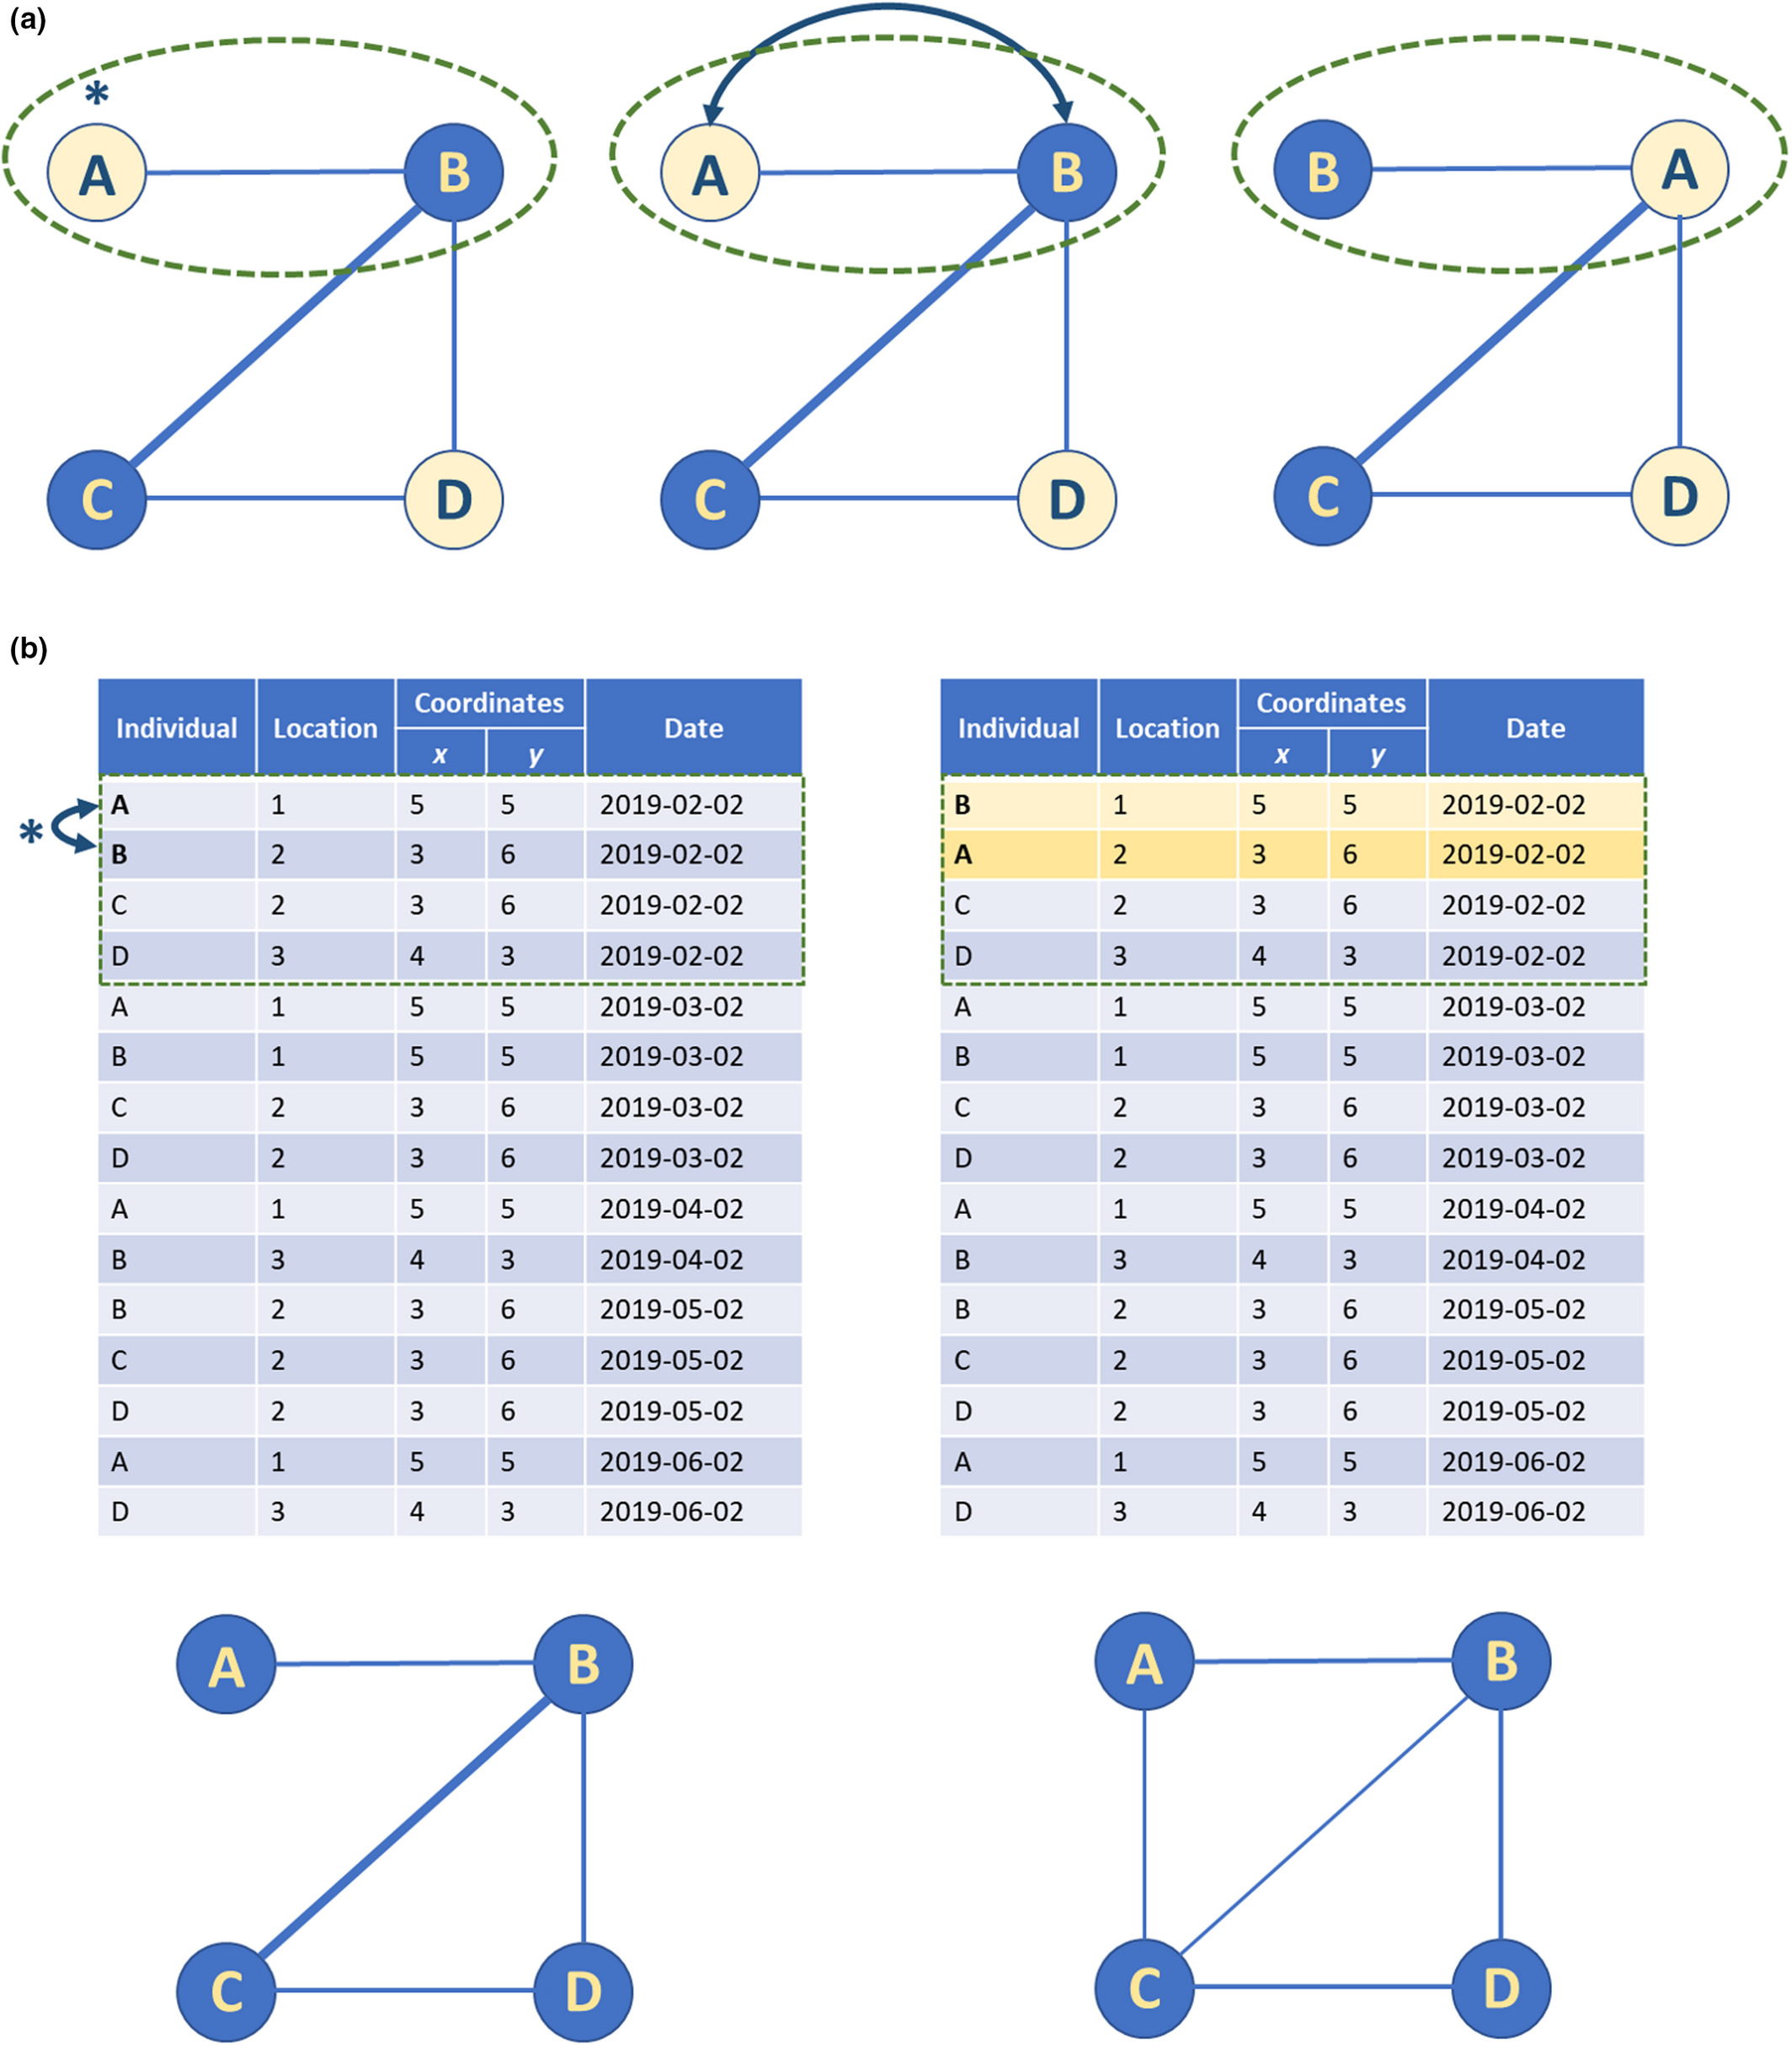
CEFE SOCIAL NETWORKS COURSE
2. Is my network important? Comparing networks to reference models
How can I generate a reference distribution with permutations?
Feature swaps
Node features
Edge features

Slide 121
CEFE SOCIAL NETWORKS COURSE
2. Is my network important? Comparing networks to reference models
How can I generate a reference distribution with permutations?
Feature swaps
Node features
Edge features
Feature swaps can be easily implemented using (re)sampling approaches in R
You can constrain feature swaps to only be between particular individuals (or edges) including using individual traits, within social communities, within spatial windows, etc.

Slide 122
CEFE SOCIAL NETWORKS COURSE
2. Is my network important? Comparing networks to reference models
How can I generate a reference distribution with permutations?
Feature swaps
Node features
Edge features
Feature swaps can be easily implemented using (re)sampling approaches in R
You can constrain feature swaps to only be between particular individuals (or edges) including using individual traits, within social communities, within spatial windows, etc.
Not sensible in very small networks

Slide 123
CEFE SOCIAL NETWORKS COURSE
2. Is my network important? Comparing networks to reference models
How can I generate a reference distribution with permutations?
Feature swaps
Node features
Edge features
Edge rewiring
In the social network
In the datastream (or bipartite network)

Slide 124
CEFE SOCIAL NETWORKS COURSE
2. Is my network important? Comparing networks to reference models
How can I generate a reference distribution with permutations?
Feature swaps
Node features
Edge features
Edge rewiring
In the social network
In the datastream (or bipartite network)
Basic edge rewiring using default functions in igraph (and other network packages)
Or you can write your own algorithms to constrain where edges can be swapped

Slide 125
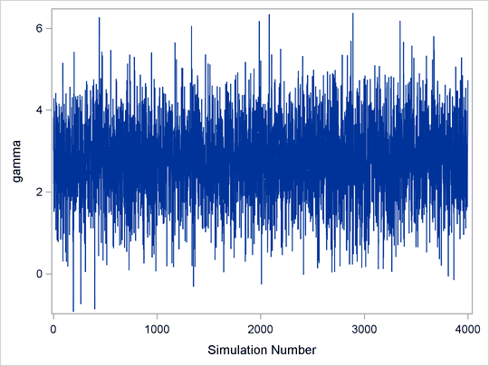
CEFE SOCIAL NETWORKS COURSE
2. Is my network important? Comparing networks to reference models
How can I generate a reference distribution with permutations?
Feature swaps
Node features
Edge features
Edge rewiring
In the social network
In the datastream (or bipartite network)
Edge rewiring creates a Markov chain (some of you will know these from Bayesian modeling)
See more here: https://doi.org/10.1111/brv.12775
and here: https://osf.io/xkvcu

Slide 126
CEFE SOCIAL NETWORKS COURSE
2. Is my network important? Comparing networks to reference models
How can I generate a reference distribution with permutations?
Feature swaps
Node features
Edge features
Edge rewiring
In the social network
In the datastream (or bipartite network)
Edge rewiring creates a Markov chain (some of you will know these from Bayesian modeling)
Important to sample in a non-biased way (e.g. if swaps are not permitted repeat the previous step)
Important to include a burn-in
Good practice to use multiple chains
See more here: https://doi.org/10.1111/brv.12775
and here: https://osf.io/xkvcu

Slide 127
CEFE SOCIAL NETWORKS COURSE
2. Is my network important? Comparing networks to reference models
How can I generate a reference distribution with permutations?
Feature swaps
Node features
Edge features
Edge rewiring
In the social network
In the datastream (or bipartite network)

Slide 128
CEFE SOCIAL NETWORKS COURSE
2. Is my network important? Comparing networks to reference models
How can I generate a reference distribution with permutations?
Feature swaps
Node features
Edge features
Edge rewiring
In the social network
In the datastream (or bipartite network)
Datastream permutations are useful for
Asking to what extent social structure differs from a null hypothesis based on movement or group size distributions
Dealing with sampling constraints

Slide 129
CEFE SOCIAL NETWORKS COURSE
2. Is my network important? Comparing networks to reference models
How can I generate a reference distribution with permutations?
Feature swaps
Node features
Edge features
Edge rewiring
In the social network
In the datastream (or bipartite network)
Be very careful when using datastream permutations
They are swaps on the underlying bipartite network and it is easy to make unanticipated changes to the social network which may mean you don’t keep features you think you are

Slide 130
CEFE SOCIAL NETWORKS COURSE
2. Is my network important? Comparing networks to reference models
How can I generate a reference distribution with permutations?
Feature swaps
Node features
Edge features
Edge rewiring
In the social network
In the datastream (or bipartite network)
Permutations have a place in animal social network analysis but are not the universal tool they have sometimes previously been treated as

Slide 131
CEFE SOCIAL NETWORKS COURSE
2. Is my network important? Comparing networks to reference models
1. Go to the R Markdown for Session 3 and work through the section SESSION 3: PART 2
There will be sub-sections on:
Node feature swaps
Edge feature swaps
Edge rewiring
Permutations have a place in animal social network analysis but are not the universal tool they have sometimes previously been treated as

Slide 132

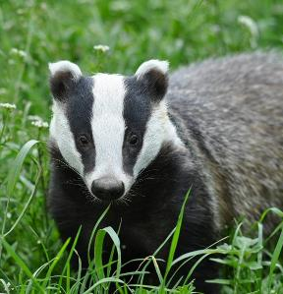
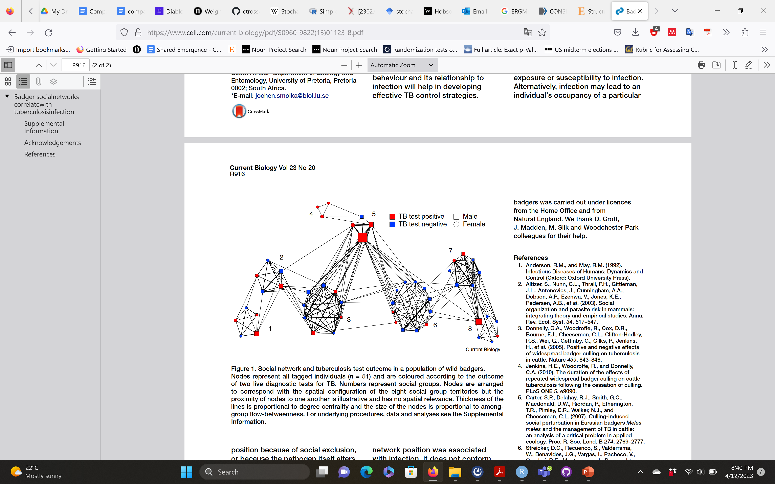
CEFE SOCIAL NETWORKS COURSE
3. Nodal regressions: using network measures to explain other traits
I might want to test a hypothesis in which individual traits are explained by network position

Slide 133
CEFE SOCIAL NETWORKS COURSE
3. Nodal regressions: using network measures to explain other traits
I might want to test a hypothesis in which individual traits are explained by network position
Body Condition ~ Clustering Coefficient + Closeness

Slide 134
CEFE SOCIAL NETWORKS COURSE
3. Nodal regressions: using network measures to explain other traits
I might want to test a hypothesis in which individual traits are explained by network position
Body Condition ~ Clustering Coefficient + Closeness
Individuals that are more socially integrated (have more friends which share friends) can spend more time feeding and so are in better body condition
Individuals with higher closeness have more access to social information on the best foraging areas and so are in better body condition

Slide 135
CEFE SOCIAL NETWORKS COURSE
3. Nodal regressions: using network measures to explain other traits
I might want to test a hypothesis in which individual traits are explained by network position
Body Condition ~ Clustering Coefficient + Closeness
Individuals that are more socially integrated (have more friends which share friends) can spend more time feeding and so are in better body condition
Individuals with higher closeness have more access to social information on the best foraging areas and so are in better body condition
The main potential issues to consider here are:
Sampling constraints
Covariance

Slide 136
CEFE SOCIAL NETWORKS COURSE
3. Nodal regressions: using network measures to explain other traits
I might want to test a hypothesis in which individual traits are explained by network position
Sampling constraints
Using association indices or binomial edge weights
Body Condition ~ Clustering Coefficient + Closeness
The main potential issues to consider here are:
Sampling constraints
Covariance

Slide 137
CEFE SOCIAL NETWORKS COURSE
3. Nodal regressions: using network measures to explain other traits
I might want to test a hypothesis in which individual traits are explained by network position
Sampling constraints
Using association indices or binomial edge weights
Controlling for numbers of observations or duration of time monitored
Body Condition ~ Clustering Coefficient + Closeness
The main potential issues to consider here are:
Sampling constraints
Covariance

Slide 138
CEFE SOCIAL NETWORKS COURSE
3. Nodal regressions: using network measures to explain other traits
I might want to test a hypothesis in which individual traits are explained by network position
Sampling constraints
Using association indices or binomial edge weights
Controlling for numbers of observations or duration of time monitored
Propagating uncertainty in edge weights - https://www.biorxiv.org/content/10.1101/2021.12.20.473541v2
Body Condition ~ Clustering Coefficient + Closeness
The main potential issues to consider here are:
Sampling constraints
Covariance

Slide 139
CEFE SOCIAL NETWORKS COURSE
3. Nodal regressions: using network measures to explain other traits
I might want to test a hypothesis in which individual traits are explained by network position
Covariance
Using animal models or spatial regression models (e.g. SAR, CAR)
Established approaches
Efficient estimation
Body Condition ~ Clustering Coefficient + Closeness
The main potential issues to consider here are:
Sampling constraints
Covariance

Slide 140
CEFE SOCIAL NETWORKS COURSE
3. Nodal regressions: using network measures to explain other traits
I might want to test a hypothesis in which individual traits are explained by network position
Covariance
Using animal models or spatial regression models (e.g. SAR, CAR)
Established approaches
Efficient estimation
Network autocorrelation models (NAMs)
User-specified dependencies among nodes
Greater subjectivity
Body Condition ~ Clustering Coefficient + Closeness
The main potential issues to consider here are:
Sampling constraints
Covariance

Slide 141
CEFE SOCIAL NETWORKS COURSE
3. Nodal regressions: using network measures to explain other traits
I might want to test a hypothesis in which individual traits are explained by network position
Go to the R Markdown for Session 3 and work through the section SESSION 3: PART 3

Slide 142
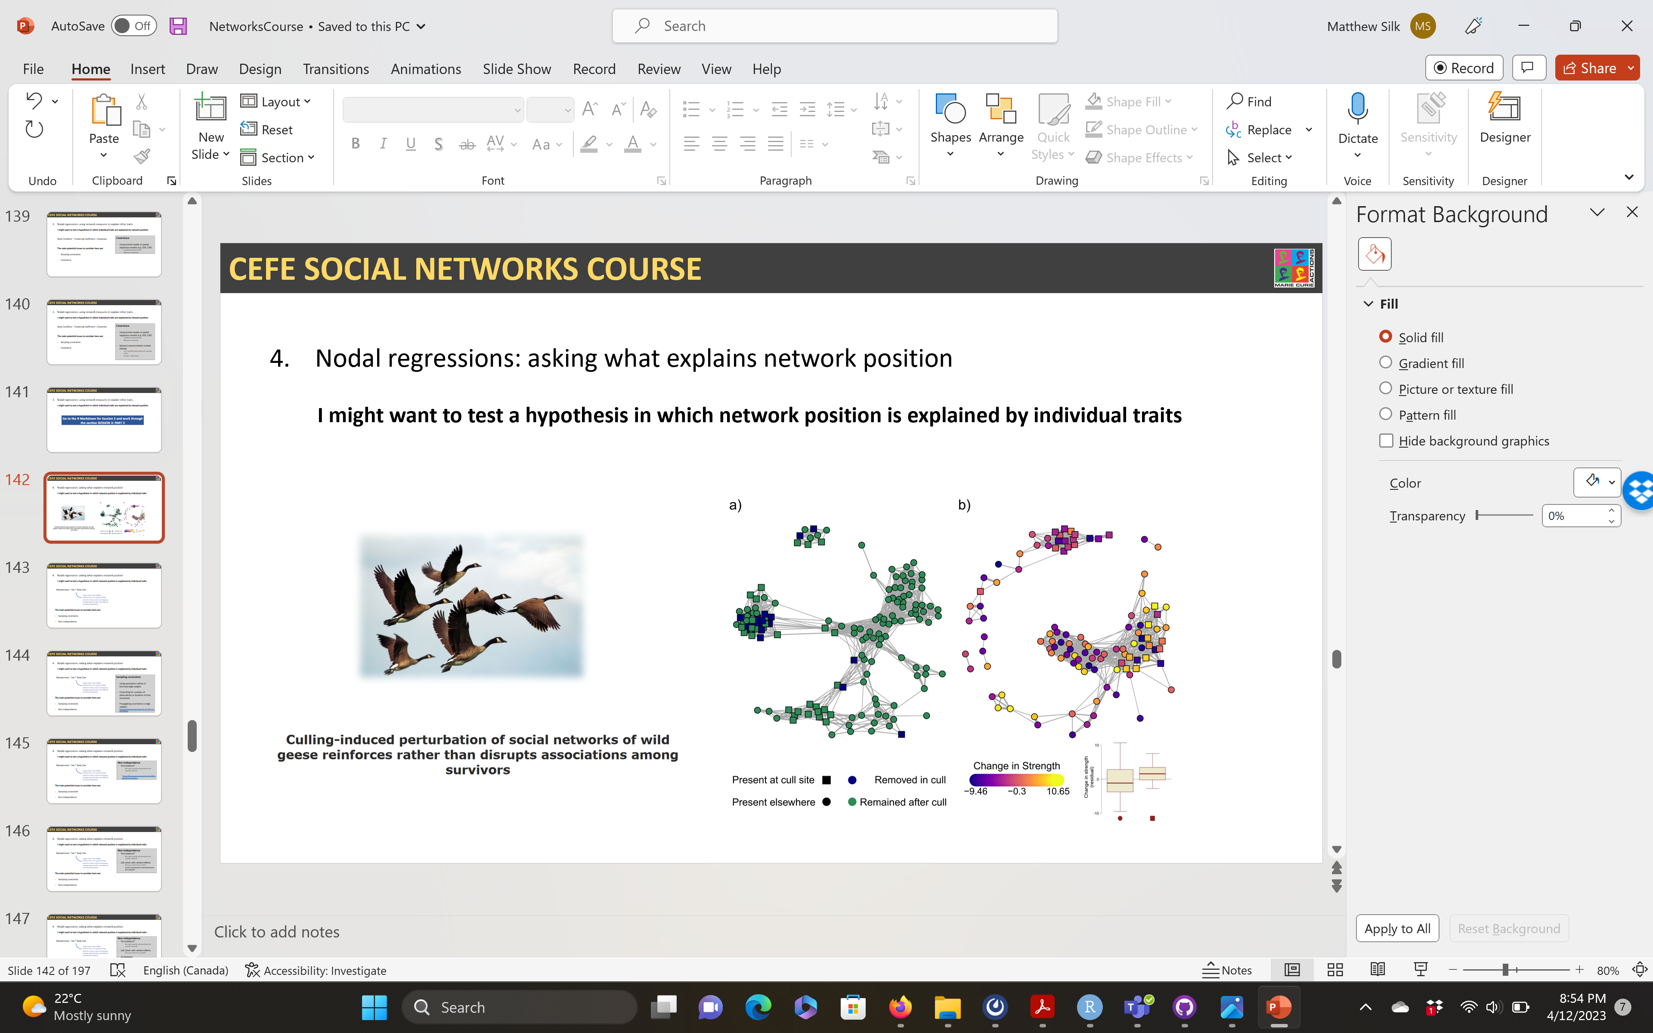


CEFE SOCIAL NETWORKS COURSE
4. Nodal regressions: asking what explains network position
I might want to test a hypothesis in which network position is explained by individual traits

Slide 143
CEFE SOCIAL NETWORKS COURSE
4. Nodal regressions: asking what explains network position
I might want to test a hypothesis in which network position is explained by individual traits
Betweenness ~ Sex * Body Size
Large males have higher betweenness in a group-living animal as they seek out-of-group mating opportunities and defend territory boundaries
The main potential issues to consider here are:
Sampling constraints
Non-independence

Slide 144
CEFE SOCIAL NETWORKS COURSE
4. Nodal regressions: asking what explains network position
I might want to test a hypothesis in which network position is explained by individual traits
Sampling constraints
Using association indices or binomial edge weights
Controlling for numbers of observations or duration of time monitored
Propagating uncertainty in edge weights - https://www.biorxiv.org/content/10.1101/2021.12.20.473541v2
Betweenness ~ Sex * Body Size
Large males have higher betweenness in a group-living animal as they seek out-of-group mating opportunities and defend territory boundaries
The main potential issues to consider here are:
Sampling constraints
Non-independence

Slide 145
CEFE SOCIAL NETWORKS COURSE
4. Nodal regressions: asking what explains network position
I might want to test a hypothesis in which network position is explained by individual traits
Non-independence
Permutations*
But only specific permutations for specific contexts
*https://link.springer.com/article/10.1007/s00265-022-03254-x
Betweenness ~ Sex * Body Size
Large males have higher betweenness in a group-living animal as they seek out-of-group mating opportunities and defend territory boundaries
The main potential issues to consider here are:
Sampling constraints
Non-independence

Slide 146
CEFE SOCIAL NETWORKS COURSE
4. Nodal regressions: asking what explains network position
I might want to test a hypothesis in which network position is explained by individual traits
Non-independence
Permutations*
But only specific permutations for specific contexts
Get clever with random effects
But you need to be careful!
Avoid using features calculated from the network
Betweenness ~ Sex * Body Size
Large males have higher betweenness in a group-living animal as they seek out-of-group mating opportunities and defend territory boundaries
The main potential issues to consider here are:
Sampling constraints
Non-independence

Slide 147
CEFE SOCIAL NETWORKS COURSE
4. Nodal regressions: asking what explains network position
I might want to test a hypothesis in which network position is explained by individual traits
Non-independence
Permutations*
But only specific permutations for specific contexts
Get clever with random effects
But you need to be careful!
Go Bayesian
Bayesian inference is a little more robust to the problems caused
Betweenness ~ Sex * Body Size
Large males have higher betweenness in a group-living animal as they seek out-of-group mating opportunities and defend territory boundaries
The main potential issues to consider here are:
Sampling constraints
Non-independence

Slide 148
CEFE SOCIAL NETWORKS COURSE
4. Nodal regressions: asking what explains network position
I might want to test a hypothesis in which network position is explained by individual traits
Non-independence
Permutations*
But only specific permutations for specific contexts
Get clever with random effects
But you need to be careful!
Go Bayesian
Bayesian inference is a little more robust to the problems caused
Use dyadic regressions or network-specific models instead
Works indirectly and only for some social network measures
Betweenness ~ Sex * Body Size
Large males have higher betweenness in a group-living animal as they seek out-of-group mating opportunities and defend territory boundaries
The main potential issues to consider here are:
Sampling constraints
Non-independence

Slide 149
CEFE SOCIAL NETWORKS COURSE
4. Nodal regressions: asking what explains network position
I might want to test a hypothesis in which network position is explained by individual traits
Go to the R Markdown for Session 3 and work through the section SESSION 3: PART 4

Slide 150
CEFE SOCIAL NETWORKS COURSE
5. Dyadic regressions
I might want to test hypotheses directly related to the edges in the network
e.g. Social network structure is associated with home range overlap
 | 1 | 2 | 3 | 4 | 5 | 6 | 7 | 8
1 | 0 | 5 | 4 | 1 | 2 | 4 | 3 | 1
2 | 5 | 0 | 3 | 5 | 2 | 1 | 2 | 1
3 | 4 | 3 | 0 | 4 | 4 | 4 | 3 | 1
4 | 1 | 5 | 4 | 0 | 2 | 1 | 1 | 2
5 | 2 | 2 | 4 | 2 | 0 | 3 | 5 | 2
6 | 4 | 1 | 4 | 1 | 3 | 0 | 3 | 2
7 | 3 | 2 | 3 | 1 | 5 | 3 | 0 | 4
8 | 1 | 1 | 1 | 2 | 2 | 2 | 4 | 0
~

Slide 151
CEFE SOCIAL NETWORKS COURSE
5. Dyadic regressions
I might want to test hypotheses directly related to the edges in the network
e.g. Social network structure is associated with home range overlap
 | 1 | 2 | 3 | 4 | 5 | 6 | 7 | 8
1 | 0 | 5 | 4 | 1 | 2 | 4 | 3 | 1
2 | 5 | 0 | 3 | 5 | 2 | 1 | 2 | 1
3 | 4 | 3 | 0 | 4 | 4 | 4 | 3 | 1
4 | 1 | 5 | 4 | 0 | 2 | 1 | 1 | 2
5 | 2 | 2 | 4 | 2 | 0 | 3 | 5 | 2
6 | 4 | 1 | 4 | 1 | 3 | 0 | 3 | 2
7 | 3 | 2 | 3 | 1 | 5 | 3 | 0 | 4
8 | 1 | 1 | 1 | 2 | 2 | 2 | 4 | 0
Matrix regression is a simple tool when finding relationships with other networks or matrices
R package sna
Uses MRQAP to assess statistical significance (a permutation test)
~

Slide 152
CEFE SOCIAL NETWORKS COURSE
5. Dyadic regressions
I might want to test hypotheses directly related to the edges in the network and node traits
e.g. Social network edges are more likely between individuals of the same sex and similar sizes
ID 1 | ID 2 | Weight | Sex | Size difference
1 | 2 | 3 | MM | 0.32
1 | 3 | 1 | MF | 0.47
1 | 6 | 1 | MF | 0.12
2 | 4 | 1 | MM | 0.05
3 | 4 | 1 | MF | 0.14
3 | 5 | 1 | FF | 0.20
5 | 6 | 2 | FF | 0.36
5 | 7 | 2 | FF | 0.11
6 | 7 | 2 | FF | 0.09
7 | 8 | 1 | MF | 0.02

Slide 153

CEFE SOCIAL NETWORKS COURSE
5. Dyadic regressions
I might want to test hypotheses directly related to the edges in the network and node traits

Slide 154
CEFE SOCIAL NETWORKS COURSE
5. Dyadic regressions
I might want to test hypotheses directly related to the edges in the network and node traits
e.g. Social network edges are more likely between individuals of the same sex and similar sizes
Multiple-membership random effects can help control for non-independence in dyadic regressions
Possible using brms (more user friendly)
Or using other Bayesian modelling frameworks (INLA, Stan, Nimble etc.)
ID 1 | ID 2 | Weight | Sex | Size difference
1 | 2 | 3 | MM | 0.32
1 | 3 | 1 | MF | 0.47
1 | 6 | 1 | MF | 0.12
2 | 4 | 1 | MM | 0.05
3 | 4 | 1 | MF | 0.14
3 | 5 | 1 | FF | 0.20
5 | 6 | 2 | FF | 0.36
5 | 7 | 2 | FF | 0.11
6 | 7 | 2 | FF | 0.09
7 | 8 | 1 | MF | 0.02

Slide 155
CEFE SOCIAL NETWORKS COURSE
5. Dyadic regressions
I might want to test hypotheses directly related to the edges in the network and node traits
e.g. Social network edges are more likely between individuals of the same sex and similar sizes
Multiple-membership random effects can help control for non-independence in dyadic regressions
Possible using brms (more user friendly)
Or using other Bayesian modelling frameworks (INLA, Stan, Nimble etc.)
The R package BISoN provides a sophisticated Bayesian framework for nodal and dyadic regressions of social networks in R. Find out more about it:
https://doi.org/10.1101/2021.12.20.473541
ID 1 | ID 2 | Weight | Sex | Size difference
1 | 2 | 3 | MM | 0.32
1 | 3 | 1 | MF | 0.47
1 | 6 | 1 | MF | 0.12
2 | 4 | 1 | MM | 0.05
3 | 4 | 1 | MF | 0.14
3 | 5 | 1 | FF | 0.20
5 | 6 | 2 | FF | 0.36
5 | 7 | 2 | FF | 0.11
6 | 7 | 2 | FF | 0.09
7 | 8 | 1 | MF | 0.02

Slide 156
CEFE SOCIAL NETWORKS COURSE
5. Dyadic regressions
I might want to test hypotheses directly related to the edges in the network and node traits
There are diverse statistical models (and associated R packages) developed specifically for networks that fit in this category, including:
STATIC
Social relations models
Stochastic block models (for community structure!!)
Exponential random graph models
Latent network models
We will talk about some of these tomorrow!

Slide 157
CEFE SOCIAL NETWORKS COURSE
5. Dyadic regressions
I might want to test hypotheses directly related to the edges in the network and node traits
There are diverse statistical models (and associated R packages) developed specifically for networks that fit in this category, including:
STATIC
Social relations models
Stochastic block models (for community structure!!)
Exponential random graph models
Latent network models
DYNAMIC
Stochastic actor-oriented models
Dynamic network actor models
Relational event models
(Dynamic versions of the models above)
We will talk about some of these tomorrow!

Slide 158
CEFE SOCIAL NETWORKS COURSE
5. Dyadic regressions
I might want to test hypotheses directly related to the edges in the network and node traits
Go to the R Markdown for Session 3 and work through the section SESSION 3: PART 5

Slide 159
CEFE SOCIAL NETWORKS COURSE
6. Comparing networks
I might want to test hypotheses related to the differences between networks
Comparing networks is DIFFICULT but NOT IMPOSSIBLE

Slide 160
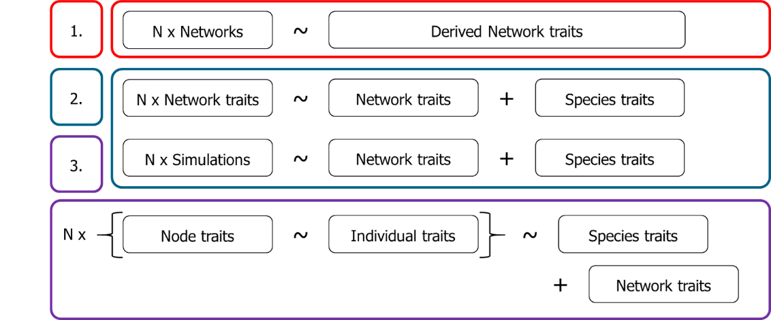
CEFE SOCIAL NETWORKS COURSE
6. Comparing networks
I might want to test hypotheses related to the differences between networks
Comparing networks is DIFFICULT but NOT IMPOSSIBLE
Comparative studies of network structure and consequences
Meta-analyses of nodal regressions

Slide 161
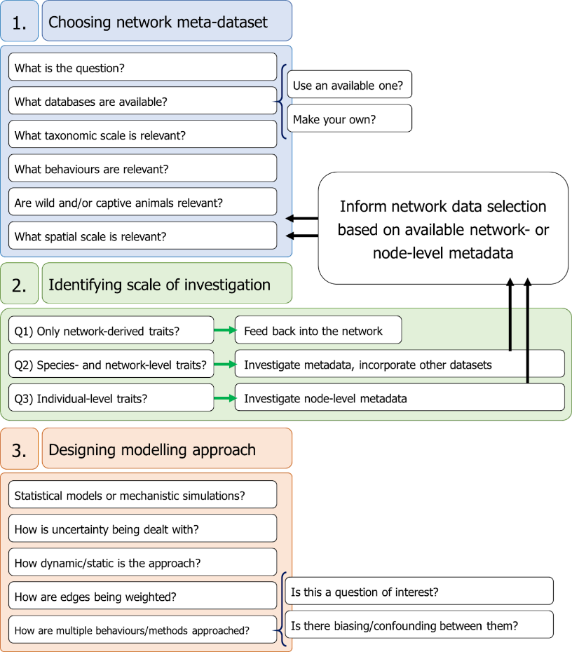
CEFE SOCIAL NETWORKS COURSE
6. Comparing networks
I might want to test hypotheses related to the differences between networks
Comparing networks is DIFFICULT but NOT IMPOSSIBLE

Slide 162
CEFE SOCIAL NETWORKS COURSE
6. Comparing networks
I might want to test hypotheses related to the differences between networks
Comparing networks is DIFFICULT but NOT IMPOSSIBLE
The most important considerations are:
Choosing relevant and comparable interactions or behaviours
Using comparable scales of study and methods (or controlling for these features)
Using comparable edge weights

Slide 163
CEFE SOCIAL NETWORKS COURSE
Comparable interactions
Does it make biological sense to compare these behaviours?
Will the nature of the interaction affect network structure?
6. Comparing networks
I might want to test hypotheses related to the differences between networks
Comparing networks is DIFFICULT but NOT IMPOSSIBLE
The most important considerations are:
Choosing relevant and comparable interactions or behaviours
Using comparable scales of study and methods (or controlling for these features)
Using comparable edge weights
Group-based
Agonistic
Affiliative

Slide 164


CEFE SOCIAL NETWORKS COURSE
Comparable interactions
Does it make biological sense to compare these behaviours?
Will the nature of the interaction affect network structure?
6. Comparing networks
I might want to test hypotheses related to the differences between networks
Comparing networks is DIFFICULT but NOT IMPOSSIBLE
Comparable scales of study
Does the approach and scale of studies lead to differences in network structure?
The most important considerations are:
Choosing relevant and comparable interactions or behaviours
Using comparable scales of study and methods (or controlling for these features)
Using comparable edge weights

Slide 165
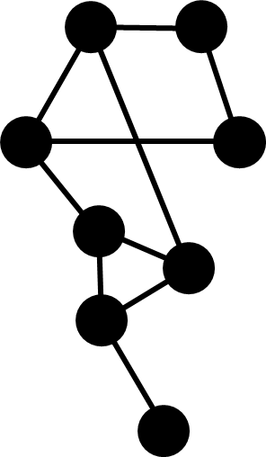
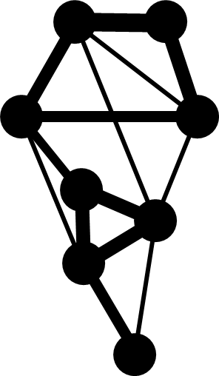
CEFE SOCIAL NETWORKS COURSE
Comparable interactions
Does it make biological sense to compare these behaviours?
Will the nature of the interaction affect network structure?
6. Comparing networks
I might want to test hypotheses related to the differences between networks
Comparing networks is DIFFICULT but NOT IMPOSSIBLE
Comparable scales of study
Does the approach and scale of studies lead to differences in network structure?
The most important considerations are:
Choosing relevant and comparable interactions or behaviours
Using comparable scales of study and methods (or controlling for these features)
Using comparable edge weights
Monitored for 1 day
Monitored for 7 days

Slide 166
CEFE SOCIAL NETWORKS COURSE
Comparable interactions
Does it make biological sense to compare these behaviours?
Will the nature of the interaction affect network structure?
6. Comparing networks
I might want to test hypotheses related to the differences between networks
Comparing networks is DIFFICULT but NOT IMPOSSIBLE
Comparable scales of study
Does the approach and scale of studies lead to differences in network structure?
The most important considerations are:
Choosing relevant and comparable interactions or behaviours
Using comparable scales of study and methods (or controlling for these features)
Using comparable edge weights
Comparable edge weights
How to control for the fact that some studies might use different types of edge weights (e.g. counts vs. durations)?

Slide 167
CEFE SOCIAL NETWORKS COURSE
6. Comparing networks
I might want to test hypotheses related to the differences between networks
Comparing networks is DIFFICULT but NOT IMPOSSIBLE
Network size is a particular challenge
Network Size
Sampling decisions
Network Structure
Network Metrics
Biological Factors

Slide 168
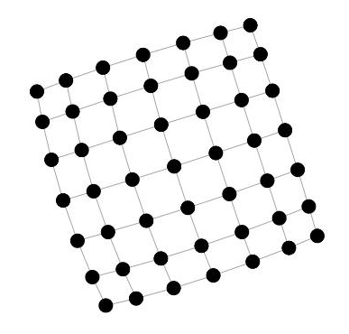
CEFE SOCIAL NETWORKS COURSE
6. Comparing networks
In a “gnp” random network, density will be independent of network size
I might want to test hypotheses related to the differences between networks
Comparing networks is DIFFICULT but NOT IMPOSSIBLE
In a lattice network density will decrease with network size
Network size is a particular challenge
Network Size
Sampling decisions
Network Structure
Network Metrics
Biological Factors

Slide 169
CEFE SOCIAL NETWORKS COURSE
6. Comparing networks
In a “gnp” random network, density will be independent of network size
I might want to test hypotheses related to the differences between networks
Comparing networks is DIFFICULT but NOT IMPOSSIBLE
In a lattice network density will decrease with network size
Network size is a particular challenge
Network Size
And these relationships won’t be nice linear ones…
Sampling decisions
Network Structure
Network Metrics
Biological Factors

Slide 170
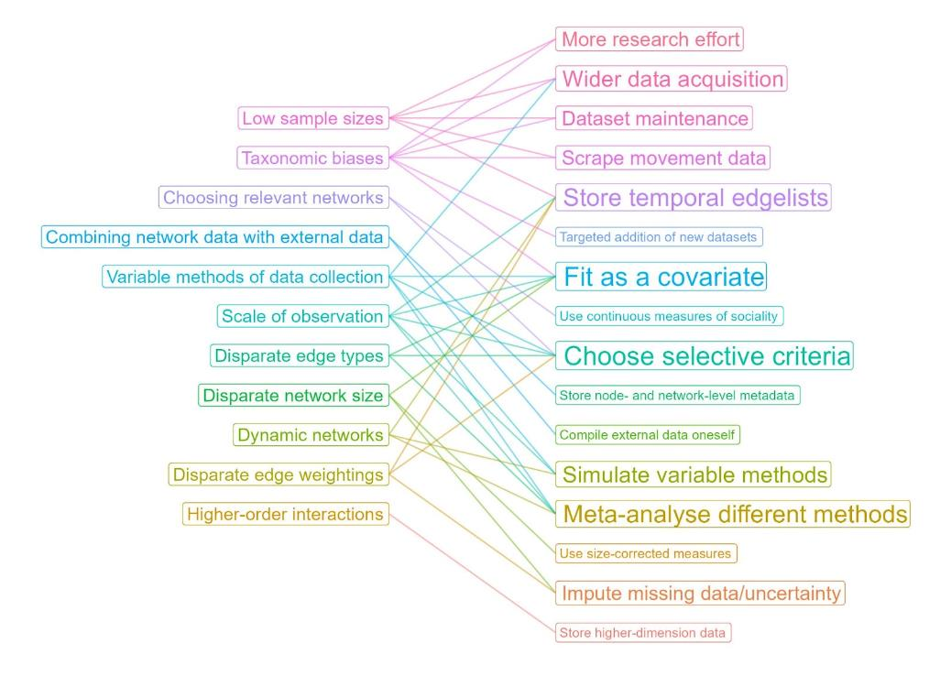
CEFE SOCIAL NETWORKS COURSE
6. Comparing networks
I might want to test hypotheses related to the differences between networks
Comparing networks is DIFFICULT but NOT IMPOSSIBLE
There are some current solutions possible – mainly careful analytical decisions
But this animal social network comparisons are very much a work in progress!

Slide 171
CEFE SOCIAL NETWORKS COURSE
Plan for the next two weeks:
03/04/2023 – What is a network?
06/04/2023 - How do we describe network structures?
13/04/2023 - How do we test hypotheses in networks?
TODAY - Extend our network skillset
Course materials: https://github.com/NETDEM-project/CEFE_Networks_Course

Slide 172
CEFE SOCIAL NETWORKS COURSE
Plan for today:
Finish from yesterday (network comparisons?)
Stochastic block models and the STRAND R package
Exponential random graph models and the network R package
An overview of dynamic network models

Slide 173
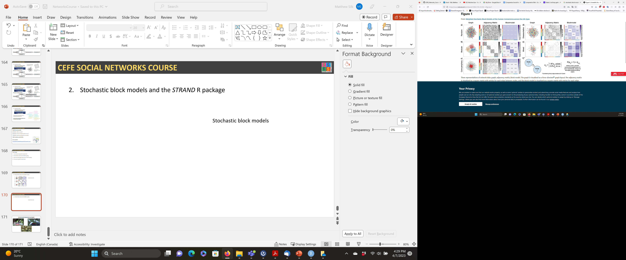
CEFE SOCIAL NETWORKS COURSE
2. Stochastic block models and the STRAND R package
Stochastic block models find groups of nodes that share similar edge probabilities with each other
These great introductory figures are from: https://doi.org/10.1038/s41598-018-31202-1

Slide 174
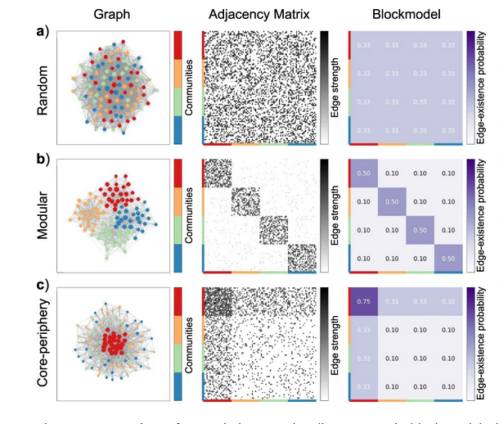
CEFE SOCIAL NETWORKS COURSE
2. Stochastic block models and the STRAND R package
Stochastic block models find groups of nodes that share similar edge probabilities with each other
These great introductory figures are from: https://doi.org/10.1038/s41598-018-31202-1

Slide 175
CEFE SOCIAL NETWORKS COURSE
2. Stochastic block models and the STRAND R package
Stochastic block models find groups of nodes that share similar edge probabilities with each other
Most commonly use to detect community structure in networks
These great introductory figures are from: https://doi.org/10.1038/s41598-018-31202-1

Slide 176
CEFE SOCIAL NETWORKS COURSE
2. Stochastic block models and the STRAND R package
But they have more flexibility than this and are a powerful tool to detect many different structures
Assortativity
Disassortativity
Mixed structures
These great introductory figures are from: https://doi.org/10.1038/s41598-018-31202-1

Slide 177
CEFE SOCIAL NETWORKS COURSE
2. Stochastic block models and the STRAND R package
SBMs have also been adapted to more complex networks:
Weighted networks
R packages STRAND, blockmodels, sbm
Signed networks
R package signnet
Bipartite networks
R package sbm
Multilayer networks
R packages sbm, rMultiNet
These great introductory figures are from: https://doi.org/10.1038/s41598-018-31202-1

Slide 178

CEFE SOCIAL NETWORKS COURSE
2. Stochastic block models and the STRAND R package
The STRAND R package is potentially a powerful friend for your network analyses. It:
Acts as an interface to fit stochastic block models in STAN
Provides models that integrate stochastic block models and social relations models
Provides a tool for simulating social network structures based on these structures
https://github.com/ctross/STRAND

Slide 179
CEFE SOCIAL NETWORKS COURSE
2. Stochastic block models and the STRAND R package
Go to the R Markdown for Session 3 and work through the section SESSION 4: PART 2
These great introductory figures are from: https://doi.org/10.1038/s41598-018-31202-1

Slide 180

CEFE SOCIAL NETWORKS COURSE
3. Exponential random graph models and the network R package
The maths underlying ERGMs is more complex but they work a lot like linear models in terms of specification and coding practicalities

Slide 181
CEFE SOCIAL NETWORKS COURSE
3. Exponential random graph models and the network R package
Possible network configurations
The observed network
The maths underlying ERGMs is more complex but they work a lot like linear models in terms of specification and coding practicalities

Slide 182
CEFE SOCIAL NETWORKS COURSE
3. Exponential random graph models and the network R package
Normalising constant
(lets not worry about this for now)
Sum over all configurations (A)
Parameter corresponding to A
Network statistic corresponding to A (1 if observed and 0 otherwise)
The maths underlying ERGMs is more complex but they work a lot like linear models in terms of specification and coding practicalities

Slide 183
CEFE SOCIAL NETWORKS COURSE
3. Exponential random graph models and the network R package
Advantages of ERGMs include:
- Natural ways to incorporate social dependencies in edge formation

Slide 184
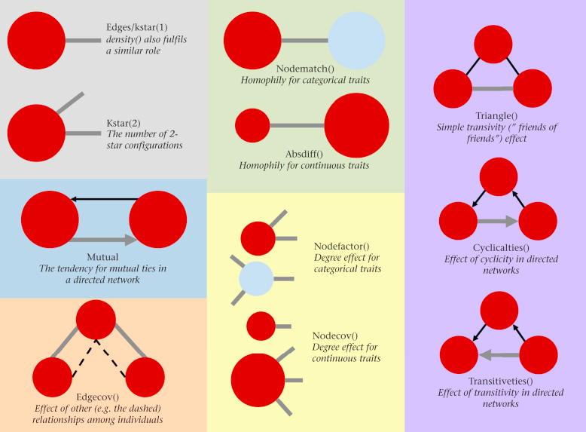
CEFE SOCIAL NETWORKS COURSE
3. Exponential random graph models and the network R package
Advantages of ERGMs include:
Natural ways to incorporate social dependencies in edge formation
Easy to include a mix of node traits, edge traits and structural features

Slide 185
CEFE SOCIAL NETWORKS COURSE
3. Exponential random graph models and the network R package
Advantages of ERGMs include:
Natural ways to incorporate social dependencies in edge formation
Easy to include a mix of node traits, edge traits and structural features

Slide 186
CEFE SOCIAL NETWORKS COURSE
3. Exponential random graph models and the network R package
Advantages of ERGMs include:
Natural ways to incorporate social dependencies in edge formation
Easy to include a mix of node traits, edge traits and structural features

Slide 187
CEFE SOCIAL NETWORKS COURSE
3. Exponential random graph models and the network R package
Advantages of ERGMs include:
Natural ways to incorporate social dependencies in edge formation
Easy to include a mix of node traits, edge traits and structural features

Slide 188

CEFE SOCIAL NETWORKS COURSE
3. Exponential random graph models and the network R package
Advantages of ERGMs include:
Natural ways to incorporate social dependencies in edge formation
Easy to include a mix of node traits, edge traits and structural features
Well developed methods for model fitting and goodness of fit

Slide 189

CEFE SOCIAL NETWORKS COURSE
3. Exponential random graph models and the network R package
Advantages of ERGMs include:
Natural ways to incorporate social dependencies in edge formation
Easy to include a mix of node traits, edge traits and structural features
Well developed methods for model fitting and goodness of fit
Bayesian implementations

Slide 190

CEFE SOCIAL NETWORKS COURSE
3. Exponential random graph models and the network R package
Advantages of ERGMs include:
Natural ways to incorporate social dependencies in edge formation
Easy to include a mix of node traits, edge traits and structural features
Well developed methods for model fitting and goodness of fit
Bayesian implementations
Can fit to and then simulate networks using built in functionality
Observed
Simulated

Slide 191
CEFE SOCIAL NETWORKS COURSE
3. Exponential random graph models and the network R package
ERGMs have been developed for:
Directed networks
Weighted networks/multigraphs
Multiplex networks
Temporal/dynamic networks
Bipartite networks (limited functionality)

Slide 192


CEFE SOCIAL NETWORKS COURSE
3. Exponential random graph models and the network R package
Drawbacks of ERGMs include:
Interpretation of coefficients slightly trickier (without simulations)
Not easily applied to grouping event based networks
(https://doi.org/10.1093/beheco/araa082)
Can have issues with model convergence and degeneracy
Uncertain how well they natively handle sampling constraints (work still to do!)

Slide 193



CEFE SOCIAL NETWORKS COURSE
3. Exponential random graph models and the network R package
In animal behaviour ERGMs may be particularly useful to:
Study dominance hierarchies

Slide 194



CEFE SOCIAL NETWORKS COURSE
3. Exponential random graph models and the network R package
In animal behaviour ERGMs may be particularly useful to:
Study dominance hierarchies
Study structural balance and compare affiliative and agonistic interactions

Slide 195



CEFE SOCIAL NETWORKS COURSE
3. Exponential random graph models and the network R package
In animal behaviour ERGMs may be particularly useful to:
Study dominance hierarchies
Study structural balance and compare affiliative and agonistic interactions
Study movement networks

Slide 196
CEFE SOCIAL NETWORKS COURSE
3. Exponential random graph models and the network R package
Go to the R Markdown for Session 3 and work through the section SESSION 4: PART 3

Slide 197



Not all social interactions are dyadic

